Slide 1

Nurse Practitioner
Preceptor Orientation
(Audio Program)
Mentoring Learners in the Primary Care Setting
Lynne Palma, DNP, FNP-BC, CDE
Nurse Practitioner Program Coordinator

Slide 2
Introduction
Thank you for the energy you have dedicated in becoming an effective preceptor for our Nurse Practitioner students at the Christine E. Lynn College of Nursing at Florida Atlantic University.
We would like to help you prepare for the role of preceptor and share with you a few suggestions for enhancing the learner preceptor relationship.

Slide 3
Orientation Program Objectives
At the end of this presentation, the clinical preceptor will be able to:
  Describe the nurse practitioner program at FAU.
  Define the role, requirements, and prerequisites of the clinical preceptors, students, and faculty.
  Identify characteristics of effective teaching strategies that will enhance the learning experience.

Slide 4
Online Preceptor Manual
Please visit the College of Nursing Website at http://nursing.fau.edu
Please see the “For Preceptors” tab on the CON Web-site for the Preceptor Manual at: http://nursing.fau.edu/?main=4&nav=628 which includes:
  Graduate Practice Programs Faculty Contacts
  Vision, Mission, Professional Statements, CON Program Outcomes, Philosophy, Graduate Curricula Overviews, Policies, Self-Insurance Plan, Reporting Critical Incidents, Responsibility of Students, Faculty, and Preceptors, Evaluation Forms, & Tuition Waiver for Preceptors from the State of Florida.

Slide 5
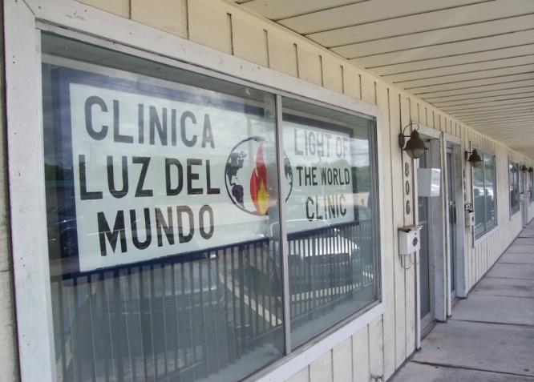
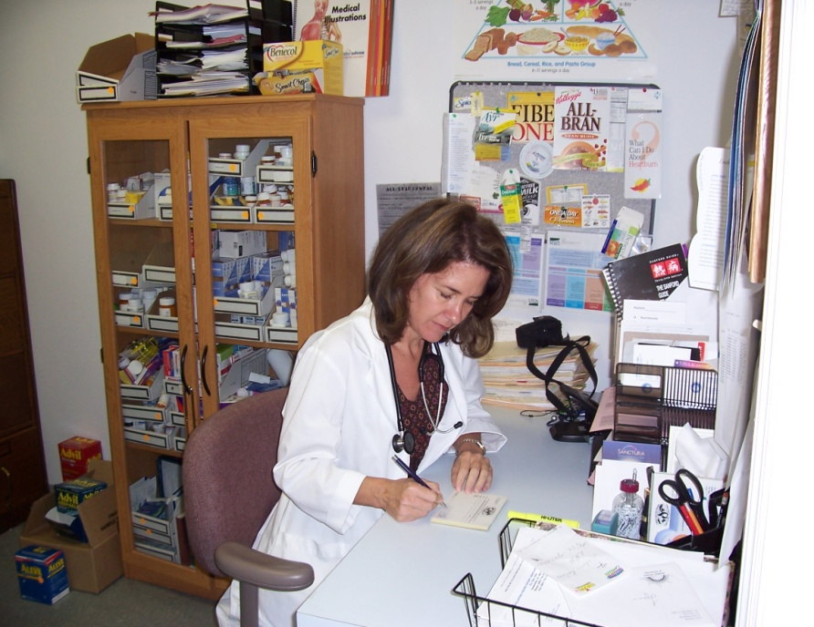
Faculty

Slide 6
Overview
What is the level of preparation of the students?
What are the responsibilities of the students, faculty and preceptors?
What are the qualification requirements to be a preceptor?
What paperwork is needed?
Why should I precept?
What are the benefits?
Is my office set up for learners?
How do patients react to office based teaching?
What kind of experience do the students need?
What do students need the most help with?
How should I prepare for the learner?
How can I have a learner and still be productive?
How can I become a better preceptor?
How can I give better feedback to the learner?
Will faculty come to the site?
Where can I get additional information and resources?

Slide 7
NP Program Information
All NP students are RNs with varying clinical experiences.
Our admission to the program is highly selective.
Program is 46-49 credit hours-8 semesters.
Three primary care courses with 600 clinical hours in primary care.
Clinical population focus is FNP or AGNP.
Doctor of Nursing Practice (DNP) students complete a total of 80-83 credits and 1000 clinical hours.
Primary care is the focus rather than acute care.
Prerequisite course include advanced pathophysiology, advanced health assessment, advanced pharmacology, research, nursing theory, roles policy, and finance, family theory, and perspectives of aging.

Slide 8
New BS-DNP Program
The Doctor of Nursing Practice (DNP) program focuses on practice leadership.
The emphasis of the program is the delivery of advanced practice nursing (APN) to culturally diverse populations, especially the burgeoning group of persons over 65 years old.
Graduate education in nursing occurs within the context of societal demands and needs as well as the inter-professional work environment.
The Institute of Medicine (IOM, 2003) and the National Research Council of the National Academies (2005) have called for nursing education that prepares individuals for practice with interdisciplinary, information systems, quality improvement and patient safety expertise.
The program is designed for Master’s prepared nursing leaders to develop skills in shaping and evaluating practice models in their own practice settings.

Slide 9
DNP Capstone Projects
The DNP capstone project is the final product which evidences the culmination of the knowledge and skills learned during the DNP program.
The aim of the DNP project is to improve the health and well-being of a group of people or advance healthcare in a meaningful way.
The choice for the project’s focus will be based on the student’s area of expertise, evidence of the specific need for the project, and feasibility of the processes planned to address the need.
Examples of DNP projects include, but are not limited to:
  evidence-based practice change initiatives
  quality improvement projects
  program needs assessment
  program development and evaluation
  evaluation of an existing program
  development of an assessment instrument or protocol for a specified population
As a requirement for graduation, the student will provide an oral and written presentation of the project to be evaluated by the student’s project committee.

Slide 10
More Examples of DNP Projects
System modification for quality improvement processes
Analyze a state or national health care policy and propose a change in the model or implementation of policy
Develop and implement information technologies to improve outcomes
Compare care and teaching models, potential cost savings, and outcomes.
Design and evaluate health care or health education programs.
Lead interprofessional collaborative projects to implement regional, state, or national policy and evaluate care models.
Lead consumer and professional coalition projects to develop, implement or evaluate programs
Translate research into practice and evaluate outcomes
Quality improvement (care processes, continuity of care, patient outcomes)
Implement and evaluate evidence based practice guidelines
Analyze policy: develop, implement, evaluate, or revise policy
Design and use databases to retrieve information for decision making, planning, evaluation
Conduct financial analyses to compare care models and potential cost savings, etc.
Design and evaluate new models of care
Design and evaluate health promotion and disease prevention programs
Assess integration of technology in care

Slide 11
Student Preparation
All NP students must meet our qualification standards.
University tracking system is Certified Background
  https://www.certifiedbackground.com/
Magnus tracker
  CPR, yearly health exam, immunizations, and health insurance
HIPAA compliance
  http://dbnursing.fau.edu/intranet/documents/medfilms/video/index.htm
  http://nursing.fau.edu/uploads/docs/864/Safety%20Guidelines%20for%20Clinical%20Practice.pdf
  Self Insurance Program (SIP)-report critical incidents (352) 273-7006
  A copy of the policy is sent to the facility when the contract is initiated. A short video is available at the following link
  http://www.flbog.sip.ufl.edu/courses/SIP_101_Partners_in_Protection/player.html

Slide 12
Student Responsibilities
Demonstrate the integration of a philosophy of caring in advanced nursing situations.
Meet all clinical entry requirements as outlined in the college clinical tracking system.
Obtain faculty site approval prior to entering any practicum.
Submit signed preceptor agreement form to faculty prior to entering any practicum site.
Submit an electronic clinical arrangements form for each practicum site prior to entering the site.

Slide 13
Student Responsibilities
Professional attire and conduct is expected at all times:
  If the student is unable to attend clinical related to illness, he/she is to contact the preceptor and facility in a timely manner. Students are expected to report to clinical on time. Tardiness is considered unprofessional behavior.
  A student ID and name badge must be exhibited.
Students must maintain advanced practice nursing electronic logs as described in individual course syllabus. Students are advised to maintain a copy of their clinical logs for their own records. The electronic logs don’t have identifiable patient information and meet HIPPA standards.

Slide 14
Student Responsibilities
Students must complete an evaluation of the advanced practice nursing site and preceptor at the end of the semester and complete a Self/Faculty Evaluation.
All ethical standards per the ANA code must be maintained, including client confidentiality.
The orientation to the setting is the responsibility of the student and is to be conducted before and/or during the first week of the semester.
The student needs to provide the preceptor, a copy of their CV/resume, a course syllabus, the advanced practice nursing evaluation tool, and a set of individualized objectives.

Slide 15
Faculty Responsibilities
FAU NP clinical faculty qualifications
  ARNP with National Certification and doctoral preparation.
  Adjunct faculty are sometimes assigned to clinical courses.
NP clinical faculty are responsible for credentialing students, preceptors, and site.
Overview of contact with preceptors
  Beginning of Term and End of Term letters.
  Consult with preceptor regarding student’s progress.

Slide 16
Faculty Responsibilities
Assist the student in facilitating an advanced practice nursing placement at the beginning of the semester; maintain contact with the facility, preceptor, and administrators as appropriate. Ensure contract is in place prior to students entering the site.
Conduct advanced practice nursing site visits as appropriate; minimally one visit per semester. This visit should be scheduled in advance to ensure the time is convenient. More than one visit may be required.
Conduct three group clinical conferences per semester.
Evaluate student, preceptor and site over the course of the semester.
Visit potential new sites. Notify NP Coordinator of sites no longer appropriate or functional.

Slide 17
Faculty Responsibilities
Maintain collegial working relationships with preceptors and staff.
Be available to preceptor and student during times that student is in advanced practice setting.
If course faculty are unavailable (out of town or ill) notify NP coordinator to arrange back up faculty supervision. Students must be notified if faculty are unavailable and the contact information of back-up supervising faculty member must be given to the student.
For each student, submit a signed summary sheet, e-log composite printout, student evaluations, and student preceptor/site evaluations to the graduate coordinator within one week of submitting course grades.

Slide 18
Preceptor Responsibilities
Required qualifications of preceptors
Types of providers
  NP with at least 1 year experience
    NP students must spend time with NP preceptors
  MD
  DO
National certification required

Slide 19
Preceptor Responsibilities
Maintain a current license to practice as an advanced practice nurse (ARNP), MD, or DO in state of practice.
Complete and sign a preceptor agreement form provided by the student and keep a copy for yourself.
Conduct a joint review with the student of the learning objectives for the advanced practice nursing experience. Should there be any problems in meeting the course objectives during the semester, the preceptor should inform the student and contact the faculty.
Provide adequate facility/clinical space to facilitate student's interaction with a variety of clients necessary for appropriate learning experiences.
Actively participate and facilitate student's experience

Slide 20
Preceptor Responsibilities
Provide an expanding scope of responsibility and accountability as the student progresses toward meeting and/or exceeding course objectives.
Participate with faculty member in evaluating student's knowledge base and clinical management skills through:
  Direct supervision, observation, and teaching of students.
  Discussion of and critique of written documentation as well as verbal presentation of cases.
  Provide written evaluation at midterm and end of the semester. Advanced practice nursing evaluation tool will be provided by faculty and/or student.
Support students in maintaining their advanced practice nursing logs and journals.

Slide 21
What paper work is needed?
Affiliate agreement
  Allison Heim: e-mail is aheim@fau.edu
Preceptor Manual on the CON Web-site
Preceptor Agreement Form is signed during the first day of clinical
Contact information for clinical faculty
Letters or e-mails sent by our clinical faculty at beginning and end of term
Recognition of hours for recertification
Syllabus and objectives
Evaluation forms-midterm and final
Verification of Clinical Hours

Slide 22
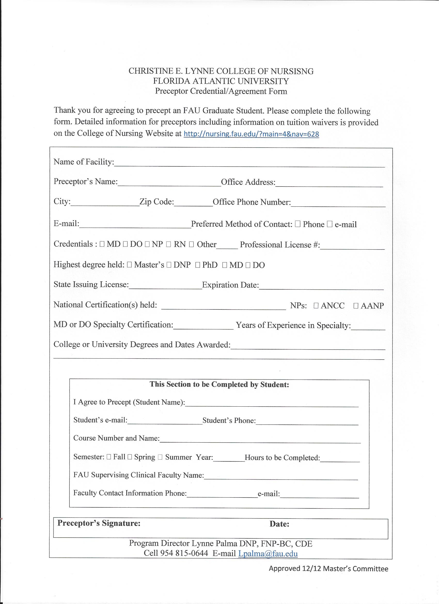

Slide 23
Why should I precept a learner?
“Giving something back”
This is the only opportunity for students to have real world experience.
The practice piece completes the cycle of learning.
The most powerful influence on a novice learner is the preceptor the provides a positive role model of the patient provider relationship.
Collaborate with other professionals.
Groom someone for hire.

Slide 24
What are the benefits?
Keeps you on your toes.
Patients often appreciate the time and attention from beginning learners.
Increased time spent in patient education.
Learners can provide additional perspective and often have something to contribute.
Tuition waiver for NPs and credit for recertification
  http://nursing.fau.edu/?main=4&nav=628
Courtesy faculty appointment.

Slide 25
Is my office set up for learners?
Make sure that you have the extra time that is required for clinical teaching.
Busy practices need to have a room in which the student can interview and perform an exam.
Do you have a place in the office for the student to work, chart or study?

Slide 26
Legal Liability while Precepting
Care provided by students must be the same standard of care provided by a licensed advanced practice professional (NP, MD, DO).
Legal and reimbursement guidelines require that preceptors validate findings on physical examination, review laboratory tests, and confirm differential diagnosis(es) and management plans with students prior to the discharge of the patient.
Review by the preceptor must be documented in the record indicating that the preceptor has examined the patient, is in agreement with the findings and plan as written by the student, and is responsible for care.
It is customary that the preceptor co-signs all records in which the student has provided documentation.

Slide 27
Patient’s Reaction to Students
According to the literature, 90% of patients indicated that quality of care and patient satisfaction were unaffected.
83% enjoyed their experience.
Rare negative experiences.
Consent should be obtained.
Office staff can inform patients that learners are present.

Slide 28
Suggestions for Obtaining Consent
“I have a nurse practitioner student working with me today. If it is OK with you, I’d like him or her to talk to you and perform a physical exam first. I will come in to see you afterwards.”

Slide 29
How should I prepare for the learner?
Interview the student before agreeing to precept to get an understanding of the level, ability, and personality of the student to assess if the student would be a “good fit” for the clinical site and the population it serves.
Contractual Agreement must be in place.
Preceptor Agreement Form must be signed.
Orientation
Shadow
Set expectations
Remind office staff-circulate information about the learner a few days before the start.
Discuss with staff how they will inform patients that there is a learner and their role in patient care.

Slide 30
When the Learner Arrives
Plan on 30-40 minutes to orient the learner
Learn about each other
Previous experiences
Review University paperwork
Expectations
Responsibilities
Office policies
Dress code
Introduction of staff-job descriptions
Office flow
Hours, lunch time
Workspace
Parking
Contents of exam room
What labs or other diagnostics are done in your office
Informing patients
Documentation
Writing prescriptions
Chart organization
Gather forms
Billing and coding
Patient teaching information, drug samples
Teaching on the fly
Recommended readings
Office resources available
Evaluation and feedback
How you want them to present the patient findings
How you want them to contact you during the day
Scheduling of patients
Selection of patients –match with learner level if possible

Slide 31
Experiences for Students
Curricular objectives can be viewed on the CON Website and are based on national standards.
  May be voluminous-focus on goals that you feel are best taught and evaluated in your setting.
We would like our students to spend most of their clinical hours in family practices, or internal medicine practices that provide care to patients with a wide variety of common and complex primary care problems.
Adult/Gerontologic (AGNP) students have additional clinical sites in the last semester.
Learners should have their own learning objectives and goals.
180-240 clinical hours each semester (2 full clinical days)

Slide 32
Ancillary Teaching Opportunities
In general, students need to have the majority of their hours engaged in decision making direct patient care. Other opportunities can be considered such as:
  Home visits
  Hospice visits
  Nursing home visits
  Lab/blood drawing
  EKG
  Giving injections/influenza
  Working with the receptionist, coder and biller, manager
  Attending staff meetings
  Triaging patient phone calls
  Chart audits

Slide 33
Additional Teaching Opportunities
Additional opportunities in areas of role development in which the student might participate include:
  legislative activities
  negotiations with 3rd party payers
  ethical case reviews
  inpatient rounds (observation)
  nursing home visits

Slide 34
Maintaining Productivity with Learners
Average additional time is 45 minutes to your day.
No loss in income.
May not want to have a student every day or have more than one student at a time.
Start them on your slow day and work up to having them there on your busiest day.
Assign the student to a patient you know likes extra time.
“Get as much of the history as you can in 10 minutes and I will come in.” Set limits on length of presentation time.
Collaborative examinations are helpful.
Have them present the patient in the room.
  Many patients report that they appreciate having their case discussed with learners because it adds to their own understanding
Notes:
Page 77 and 78

Slide 35
Benefits to Presenting in the Room
It saves time.
Patients perceive it as being more confidential.
Patients are not waiting alone in the room.
Patients prefer to hear what is being said about them.
Learners tend to make more concise presentations.
Patients can verify information and correct misinformation.
It increases the preceptors “face-to-face” time with the patient.
The preceptor can immediately collect additional information from the patient.
Patients feel that they are part of the process.
There are also disadvantages…..give ground rules of what can be discussed.

Slide 36
What do students need the most help with?
Working within time restraints.
Learning to rely on data gathering skills and problem solving skills rather than on imaging and laboratory tests.
Every patient will be a “new patient” to the student and they may spend an inordinate amount of time collecting data in the beginning.
Performing a focused exam.
  Have them show you the “5 minute exam”
Promotion of independence.

Slide 37
How can I become a better preceptor?
Mastering the preceptor role:
  Orient the learner
  Provide expectations
  Observe
  Increase responsibility level
  Engage and ask the learner
  Evaluate the learner and provide feedback

Slide 38
Expectations
Set clear expectations for the preceptorship
  Define expectations for documentation in the medical record.
  Students should present written documentation if not allowed to use electronic medical records.
  Prescriptions should not be signed until checked by the preceptor.

Slide 39
Observation
Observe the student’s performance as often as possible.
Directly observe vital history-taking and physical exam skills in order to give guidance to the learner.

Slide 40
Meaningful Responsibility
The amount of responsibility depends on the learner’s level of training and your best judgement.
Learners need the opportunity to see patients independently, collect data, make preliminary decisions, and then report back to you.
Allowing increasing independent supervised responsibility increases their learning.

Slide 41
Engage the Learner
  Get a verbal commitment from the student regarding the diagnosis and treatment plan.
    The diagnosis and plan is always the most difficult part for RNs as they transition into the NP role.
    Even beginning learners should be able to diagnosis a variety of common conditions and offer a plan of treatment.

Slide 42
Ask the Learner
Probe the learner for their thought processes.
  Asking a learner is better than telling them because you get an idea of their level of understanding.
  Open ended questions can be used for more advanced learners.
  “What do you think is going on with the patient?” “What is the supporting evidence?” What are the differential diagnoses?” “What is your plan?” “What is your rationale for your treatment?”
Notes:
Example page 55 of a patient with pneumonia
Example of general rule page 56

Slide 43
Ask the Learner
  New NP students need the most help in forming differentials and knowing what questions to ask to “rule out” the differentials.
  Sometimes, you may want to “prime” the learner by giving critical information to help initiate the visit.
  The learner should be prepared with resources to look up treatments for suspected diagnoses.

Slide 44
Get a Commitment
Get a commitment for the student
  What do you think is going on with this patient?
Help students “think on their feet”
Probe for supporting evidence
  Why do you think that? What are the findings that led you to that diagnosis? Why did you choose an ACE inhibitor over a beta blocker? Help the learner think out loud.
Teach general rules
  “Always do this when you see similar cases”
Reinforce what was done right
  “Here is what you did right, and this is why it is important.”
Correct mistakes
  “I will make suggestions on how to do it better.”
Notes:
Page 53
Page 58-59

Slide 45
Self Directed Learning and Reflection
1. Based on the patients you saw today, what are your questions?
2. What did you learn today?
3. What is the most important thing that happened today?
4. What is the one thing you would like to learn more about?
5. What troubled you today?
6. What might you improve on?

Slide 46
Student Preparation for Clinical
Help the student with evidence based practice.
Consider giving them homework such as:
  Is a 7 day course of Bactrim superior to a 3 day course?
  Read about uncomplicated cystitis.
Follow up with them during the next meeting.

Slide 47
Preceptor Pitfalls
Taking over the case.
Asking too many questions.
Not allowing sufficient “wait time.”
Pushing the learner past his or her ability.
Not giving feedback.
Notes:
Page 70-72

Slide 48
Giving Feedback to the Learner
Ask your patients regarding their experience with the learner.
Brief and formal feedback is recommended.
Most errors that persist with students are the result of insufficient feedback.

Slide 49
Feedback Tips
The goal is to:
  Provide feedback that is respectful to the learner.
  Results in change of behavior.
Set expectations-feedback that is expected is more easily accepted by the learner.
The purpose is for continued improvement.
Focus the feedback in terms on describing behaviors that can be changed and focus on future behavior.
Learner self assessment can be helpful.
Notes:
Page 100

Slide 50
Feedback Sandwich
What was done wrong?
What was done right?
What can be done next time?
Notes:
Example 103

Slide 51
Barriers to Effective Feedback
Fear of upsetting learner.
Softening the feedback so that the message is lost.
Written feedback tends to be more critical than face-to-face.
Feedback may be too general.
Grade inflation.

Slide 52
Evaluation
Formative and summative evaluations are required by the preceptor.
Observe the student’s performance as often as possible.
    Directly observe vital history-taking and physical exam skills in order to give guidance to the learner.
Student evaluation (grade) is the responsibility of the NP faculty with input from the preceptor
Let the clinical faculty know early on regarding student deficits.
A Report of Unsatisfactory Work form needs to be completed by University clinical faculty for students that are not performing as expected.

Slide 53
Behaviors that indicate the student is “getting it”
Presents thorough, focused history and physical.
Consistently articulates sound decision making.
Develops and implements reasonable plan.
Connects with patient interpersonally in caring manner.
Is organized, independent, time-efficient.
Is self-confident but knows limits; asks for help.
Has holistic view of care; includes health promotion and disease prevention.
Provides concise charting and oral presentations.

Slide 54
Red Flag Behaviors of Students
Is hesitant, anxious, defensive, not collegial.
Has uneasy rapport with patient and misses cues.
Presents less focused history and physical with excessive incomplete data.
Performs physical examination poorly, inconsistently.
Is unable to explain reasoning for diagnosis.
Is unable to prioritize patient problems.
Is unable to create plans independently.
Misses health education and disease prevention opportunities in plan.
Is unsure of tests to order.
Is unable to provide clear charting and presentations.

Slide 55
Addressing Problems with Learner’s Clinical Performance
Steps for problem/conflict management include recognition, assessment, strategy, and prevention.
Talk to student.
Contact FAU clinical faculty.
Keep notes with specific examples.
Try different teaching strategies.
Does the learner need exposure to different types of patients?

Slide 56


Site Visit by FAU Clinical Faculty
Clinical faculty are required to come to the site to evaluate the student.
We will observe like a “fly on the wall” without providing input until after the students has presented to the preceptor.
A brief visit with the preceptor in private is requested.

Slide 57
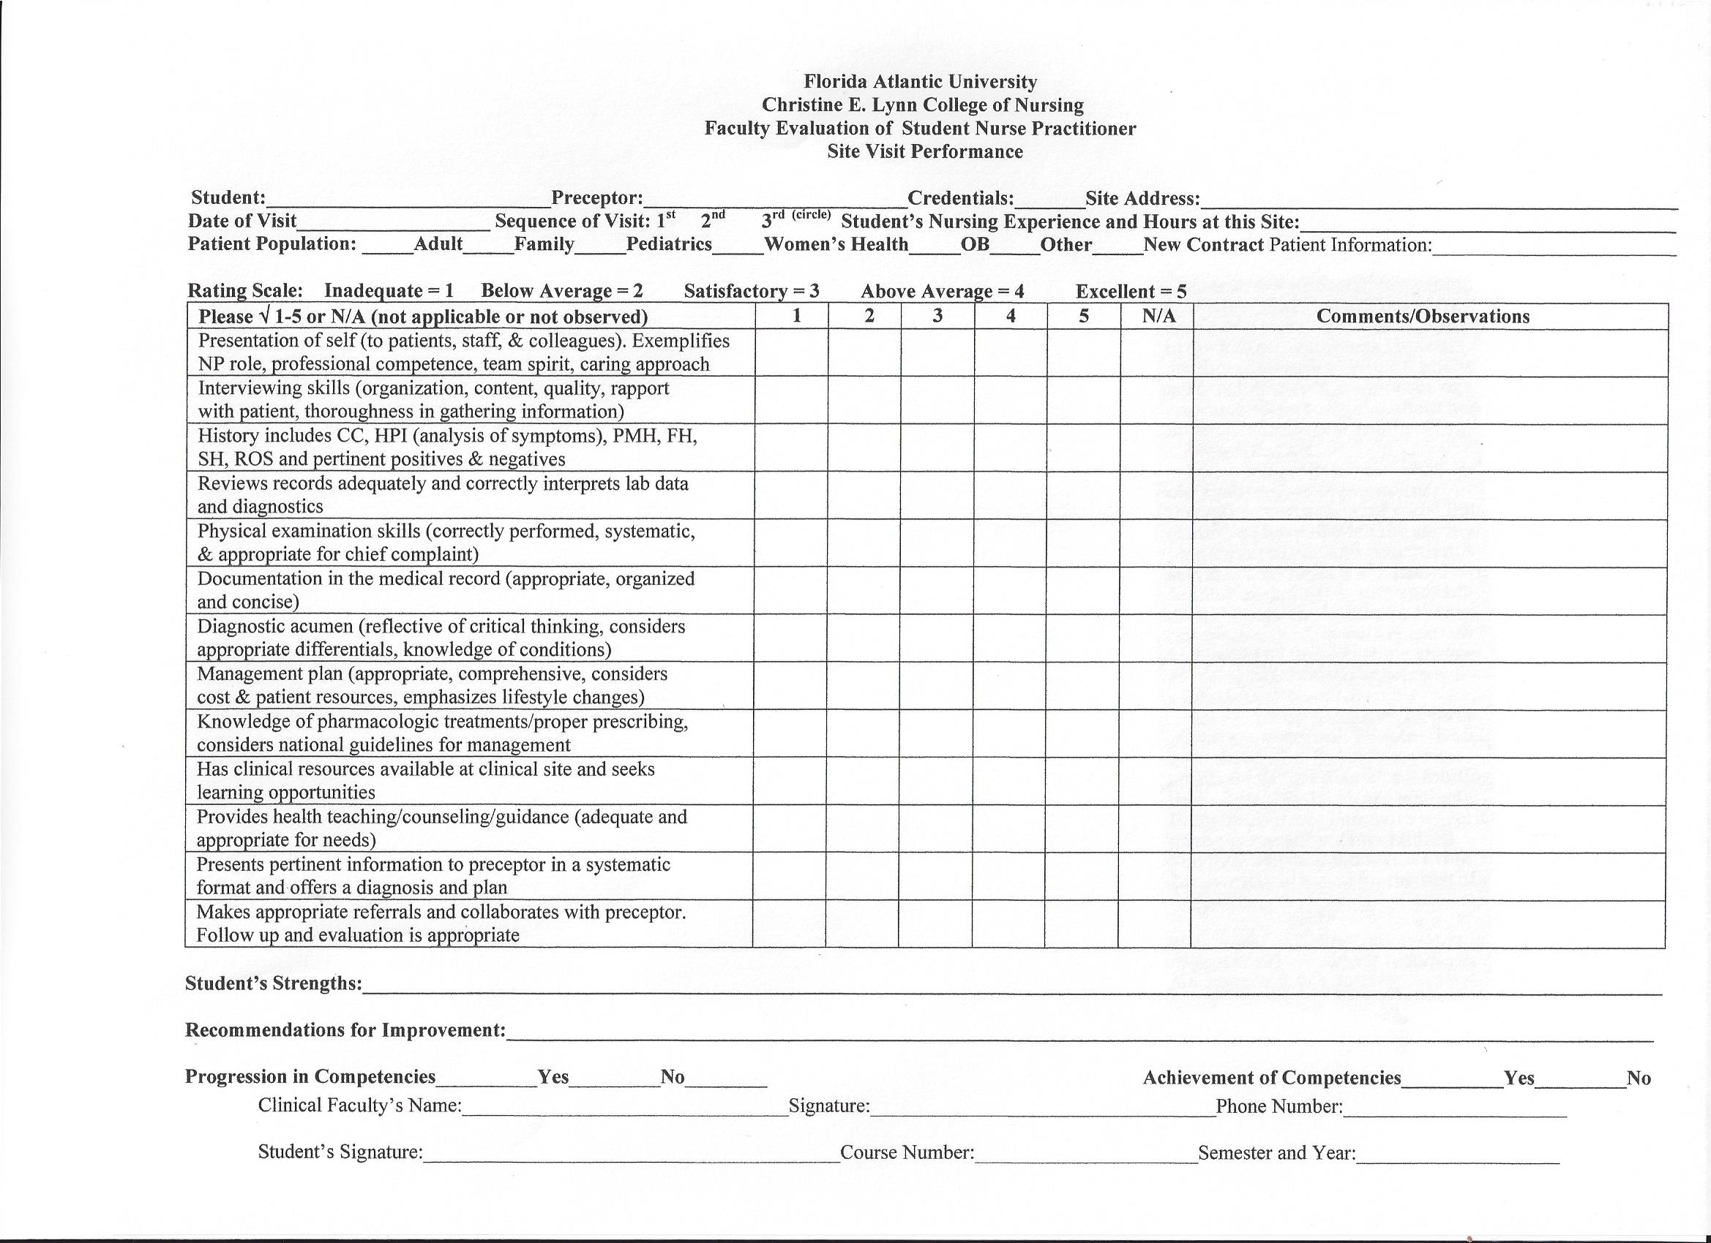
Site Visit Performance Form

Slide 58
Summary and Evaluation
Please send me an email with your suggestions on how to improve this preceptor orientation presentation.
  Lpalma@fau.edu
  Call or text me (preferred) at 954 815-0644.
  Office number is 561 297-3726.
College on Nursing Website is located at: http://nursing.fau.edu

Slide 59
Additional Contact Information
Shirley Gordon Assistant Dean Graduate Program
  sgordon@fau.edu 561 297-3389
Carol Kruse Master’s Program Assistant
  ckruse@fau.edu 561 297-3261
Josie Weiss Harbor Branch Campus Coordinator
  jweiss21@fau.edu 772-873-3374
Debra Hain AGNP Lead Faculty
  dhain@fau.edu 561 297-4301
Sue Bulfin Director of the Doctor on Nursing Program (DNP)
  sbulfin@fau.edu 561 297-3600
Krisa Kolbe DNP Program Assistant
  kkolbe@fau.edu 561 297-1109
Alison Heim Contracts Administrator
  aheim@fau.edu 561 297-1110

Slide 60
Certificate of Completion
This Acknowledges That
has successfully completed
Preceptor orientation: mentoring learners in the ambulatory care setting
Christine E. Lynn College of nursing
Florida atlantic university
Lynne palma, dnp, fnp,-bc, cde
Program Coordinator
date

Slide 61
Resources and Bibliography
Alguire, P. C., DeWitt, D. E., Pinsky, L, E., Frenchick, G. S (2008). Teaching in your office: A guide to instructing medical students and residents. Second Edition. American College of Physicians: Philadelphia.
Barker E. R. & Pittlan, O. (2010) Becoming a super preceptor: A practical guide to preceptorship in today’s clinical climate. Journal of American Academy of Nurse Practitioners, 22, 144-149.

Slide 62
Resources and Bibliography
Bott, G., Mohide, A., & Lawlor, Y. (2001). A clinical teaching technique for nurse preceptors: The five minute preceptor. Journal of Professional Nursing, 27(1), 355-42.
Brooks, M. V. & Niederhauser, V. P. (2010). Preceptor expectations and issues with nurse practitioner clinical rotations. Journal of American Academy of Nurse Practitioners, 22, 573-579
Buchel, T. L., Edwards, F. D. (2005). Characteristics of effective Clinical Teachers. Family Medicine, 37 (1).
Burns, C, Beauchesne, M., Ryan-Krause, P., Sawin, K. (2006). Mastering the preceptor role: Challenges of clinical teaching. Journal of Pediatric Health Care, 20 (1), 72-183.

Slide 63
Resources and Bibliography
Department of Health and Human Services (2011). Guidelines for Teaching Physicians, Interns, and Residents ICN 006347
Gerontological Advanced Practice Nurses Association. Preceptor Toolkit. www.GAPNA.org
National Organization of Nurse Practitioner Faculties-NONPF (2005) Partners in NP education: A Preceptor manual for NP programs, faculty, preceptors & students. NONPF: Washington, DC.
Neher, J.O., Gordon, KC, Meyer, B, & Stevens, N. (1992). A Five-step "Microskills" Model of Clinical Teaching. Journal of the American Board of Family Practice, 5, 419-424.

