Slide 1
FAU Postdoc Appreciation Week
Celebration Event
September 24, 2026
***
Photo Credit: Alex Dolce, Assistant Director, Photography, Division of University Communications

Slide 2
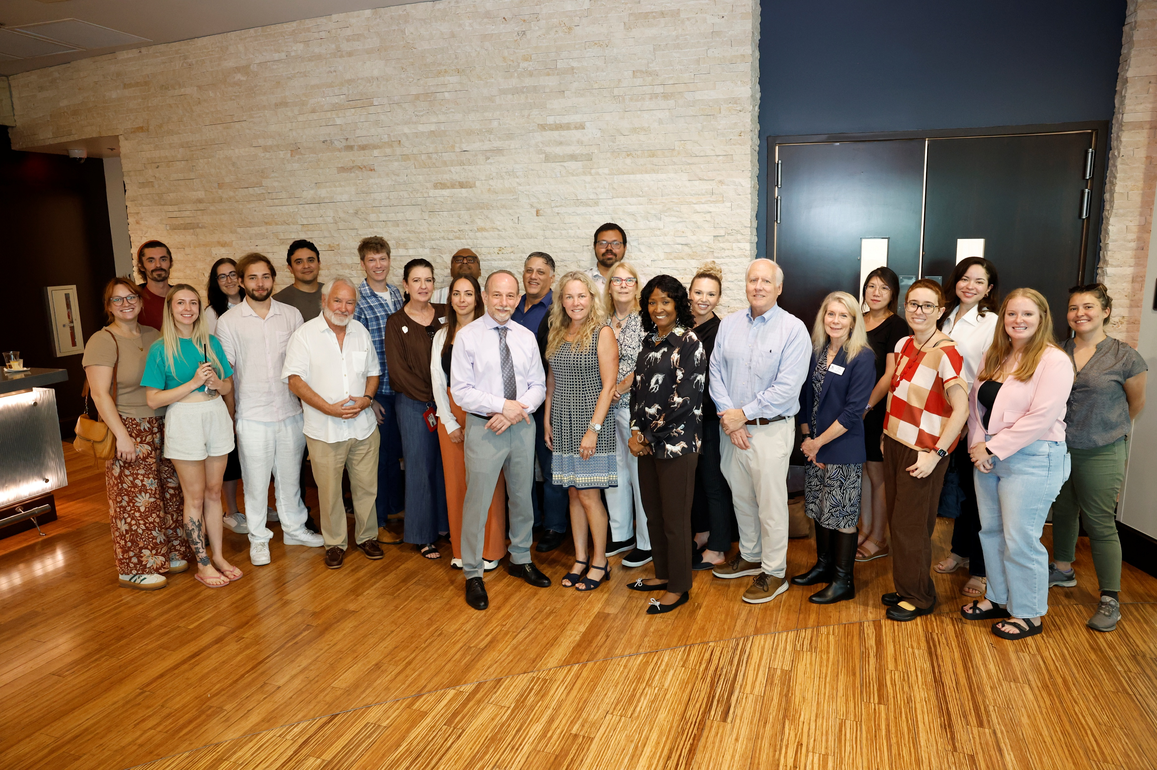
Postdoc Appreciation – Group Picture

Slide 3
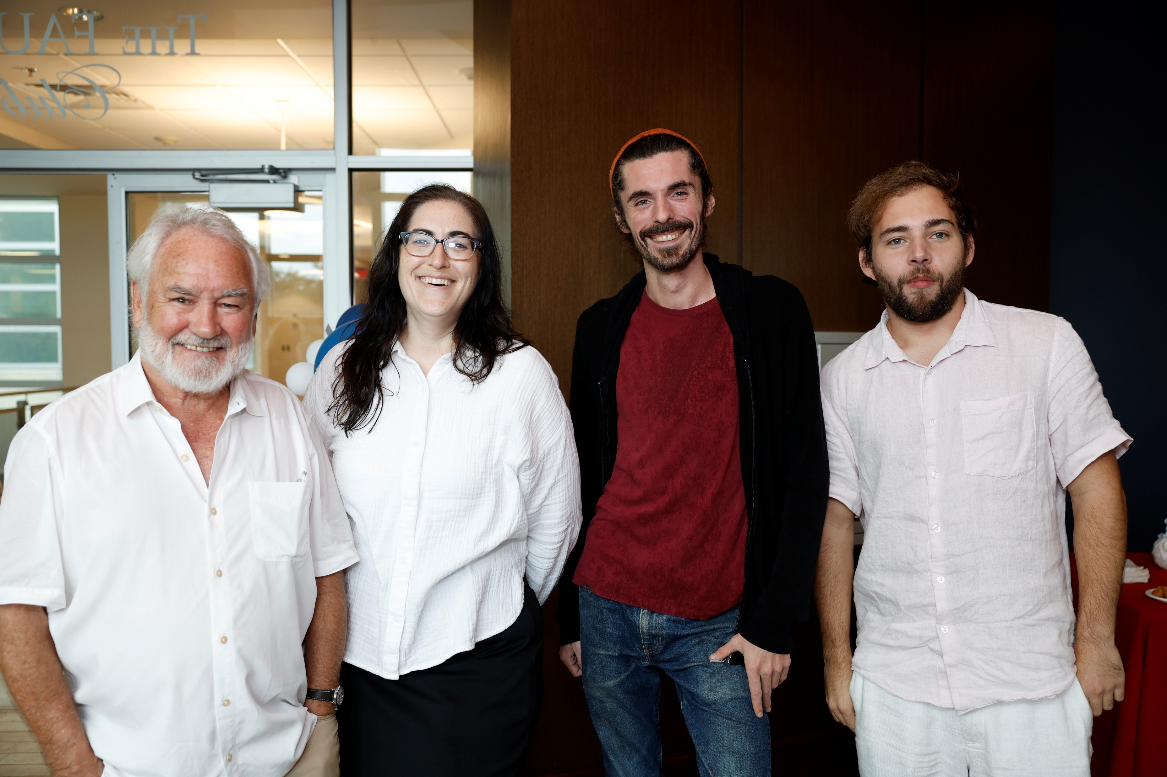
Dr. Scott Kelso and Postdocs

Slide 4
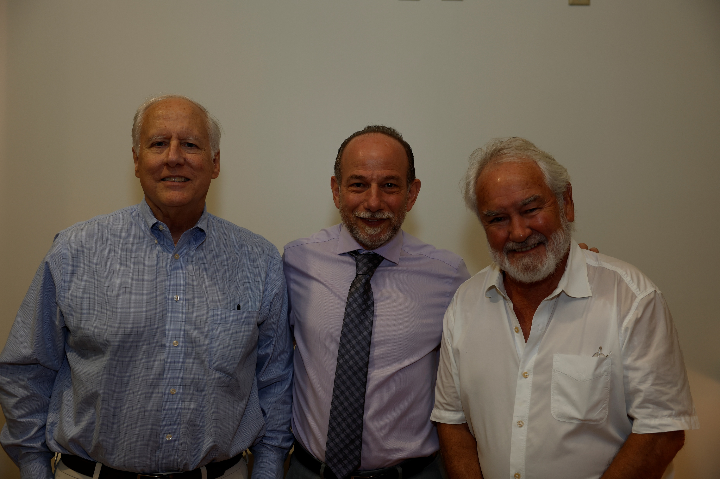
Dr. Blakely, Dr. Fields, Dr. Kelso

Slide 5
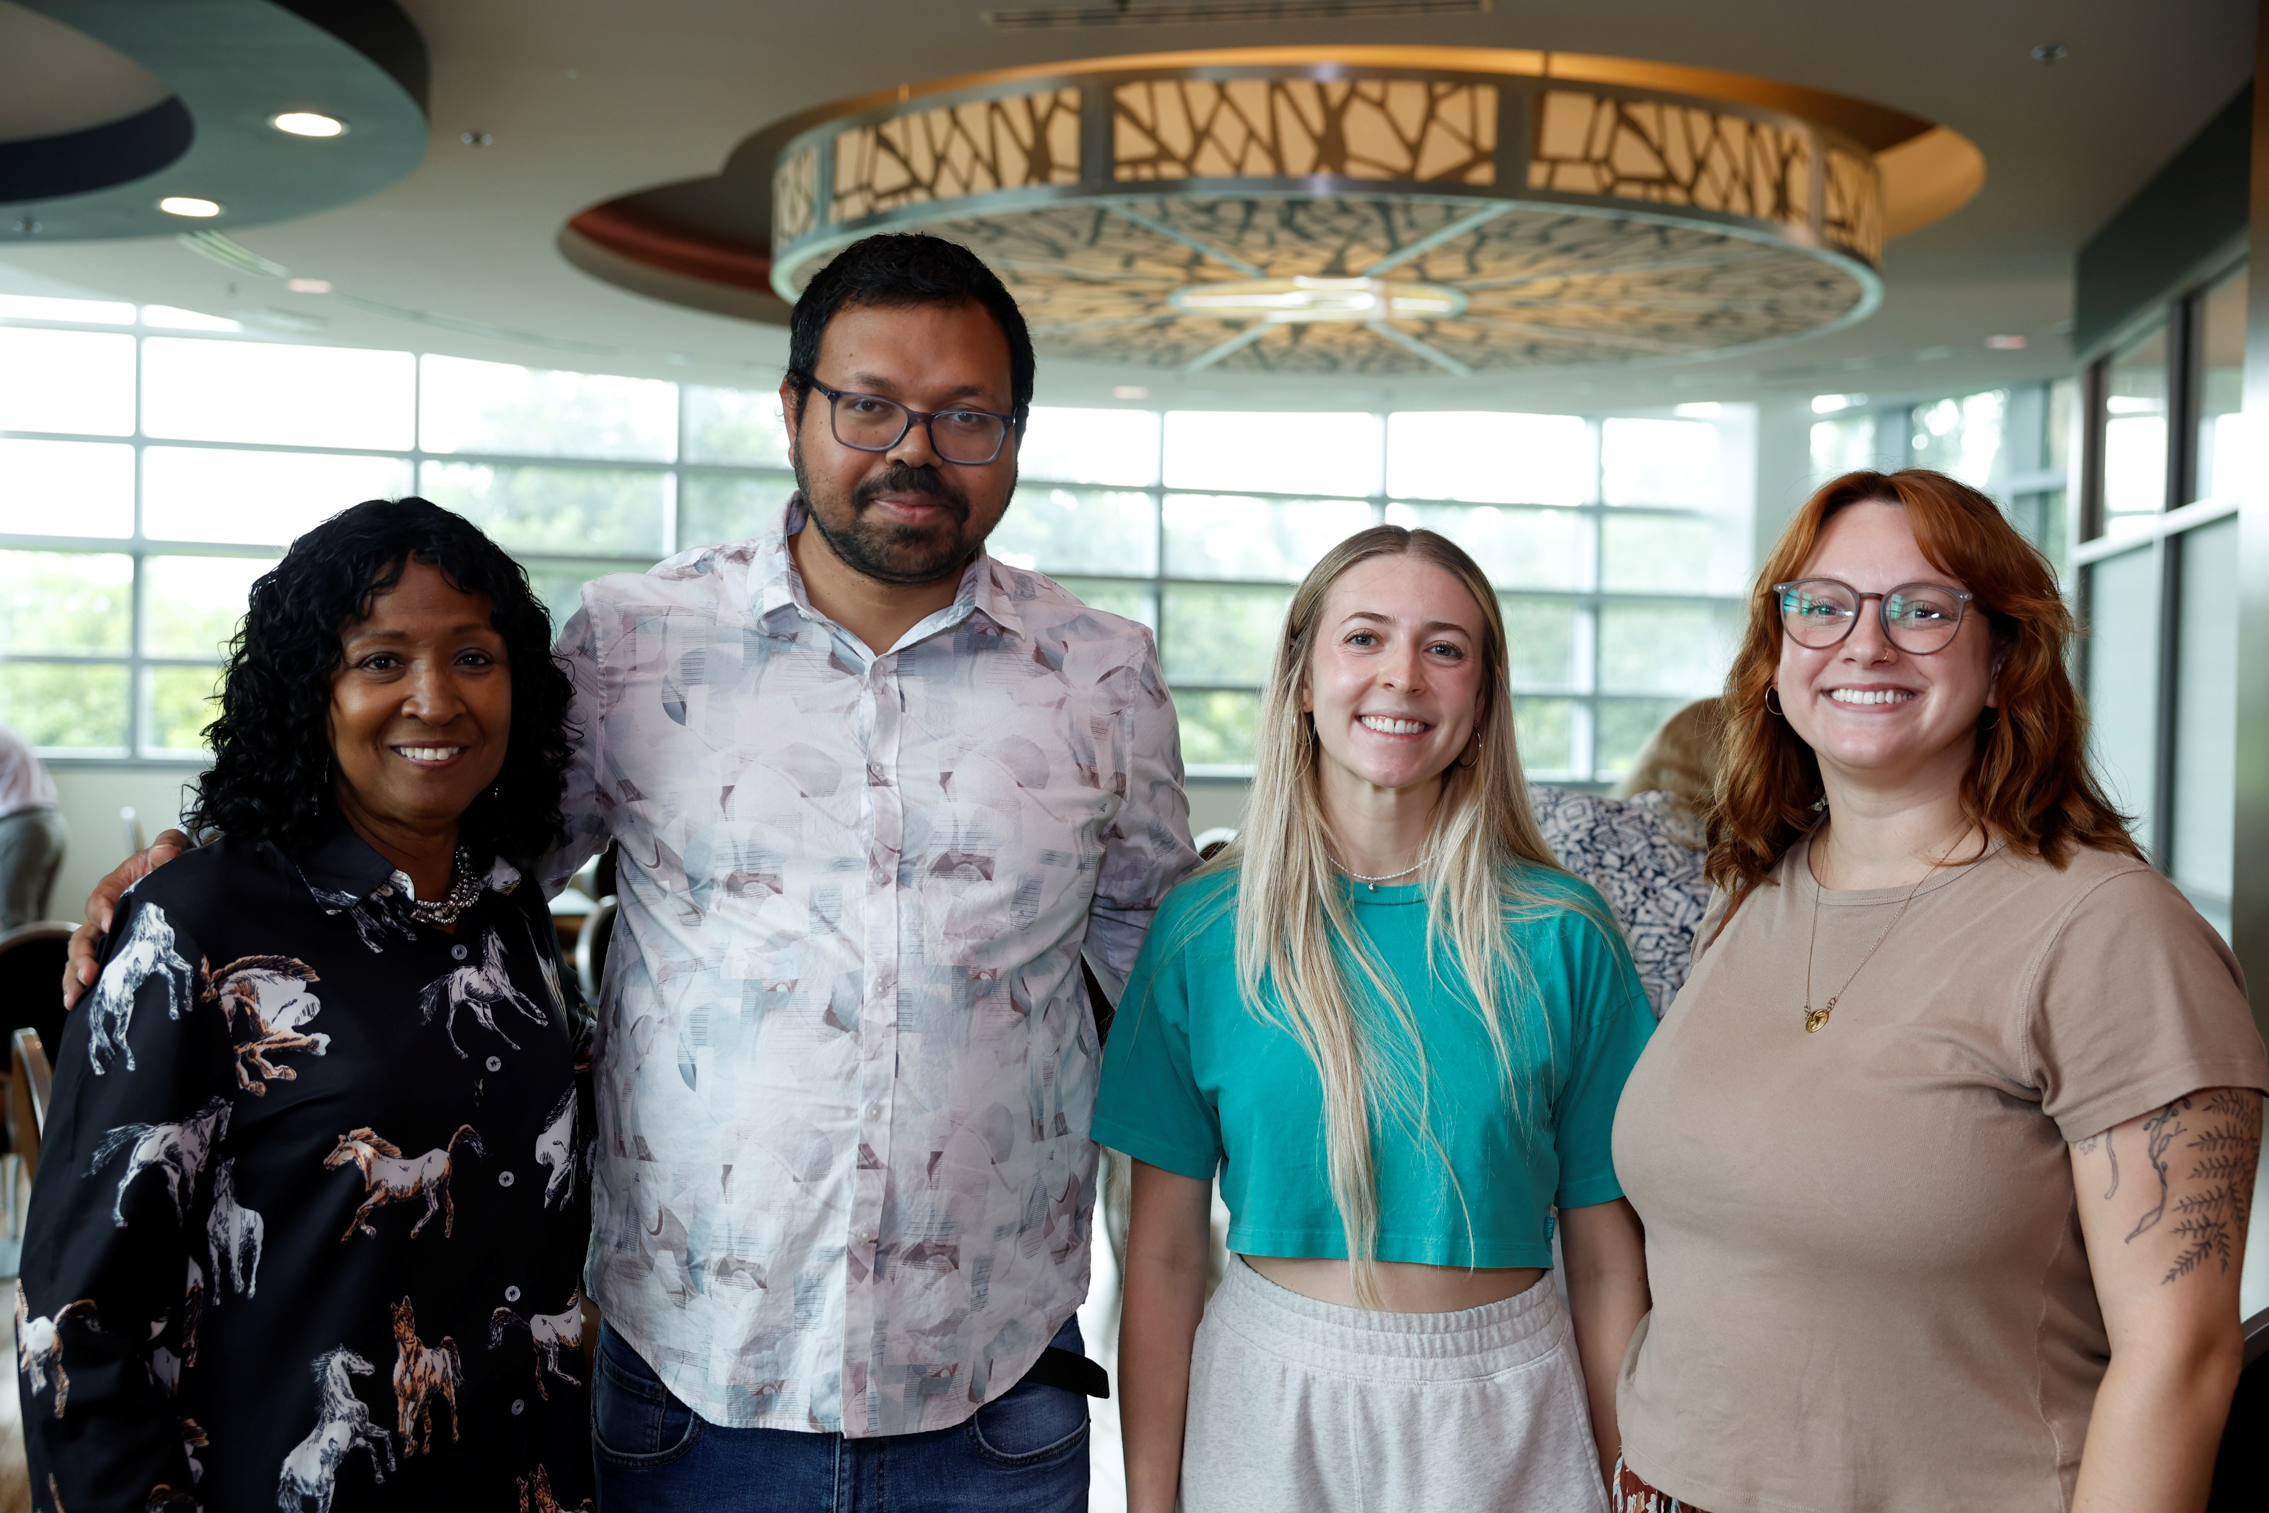
FAU Postdoc Association Board President and postdocs

Slide 6
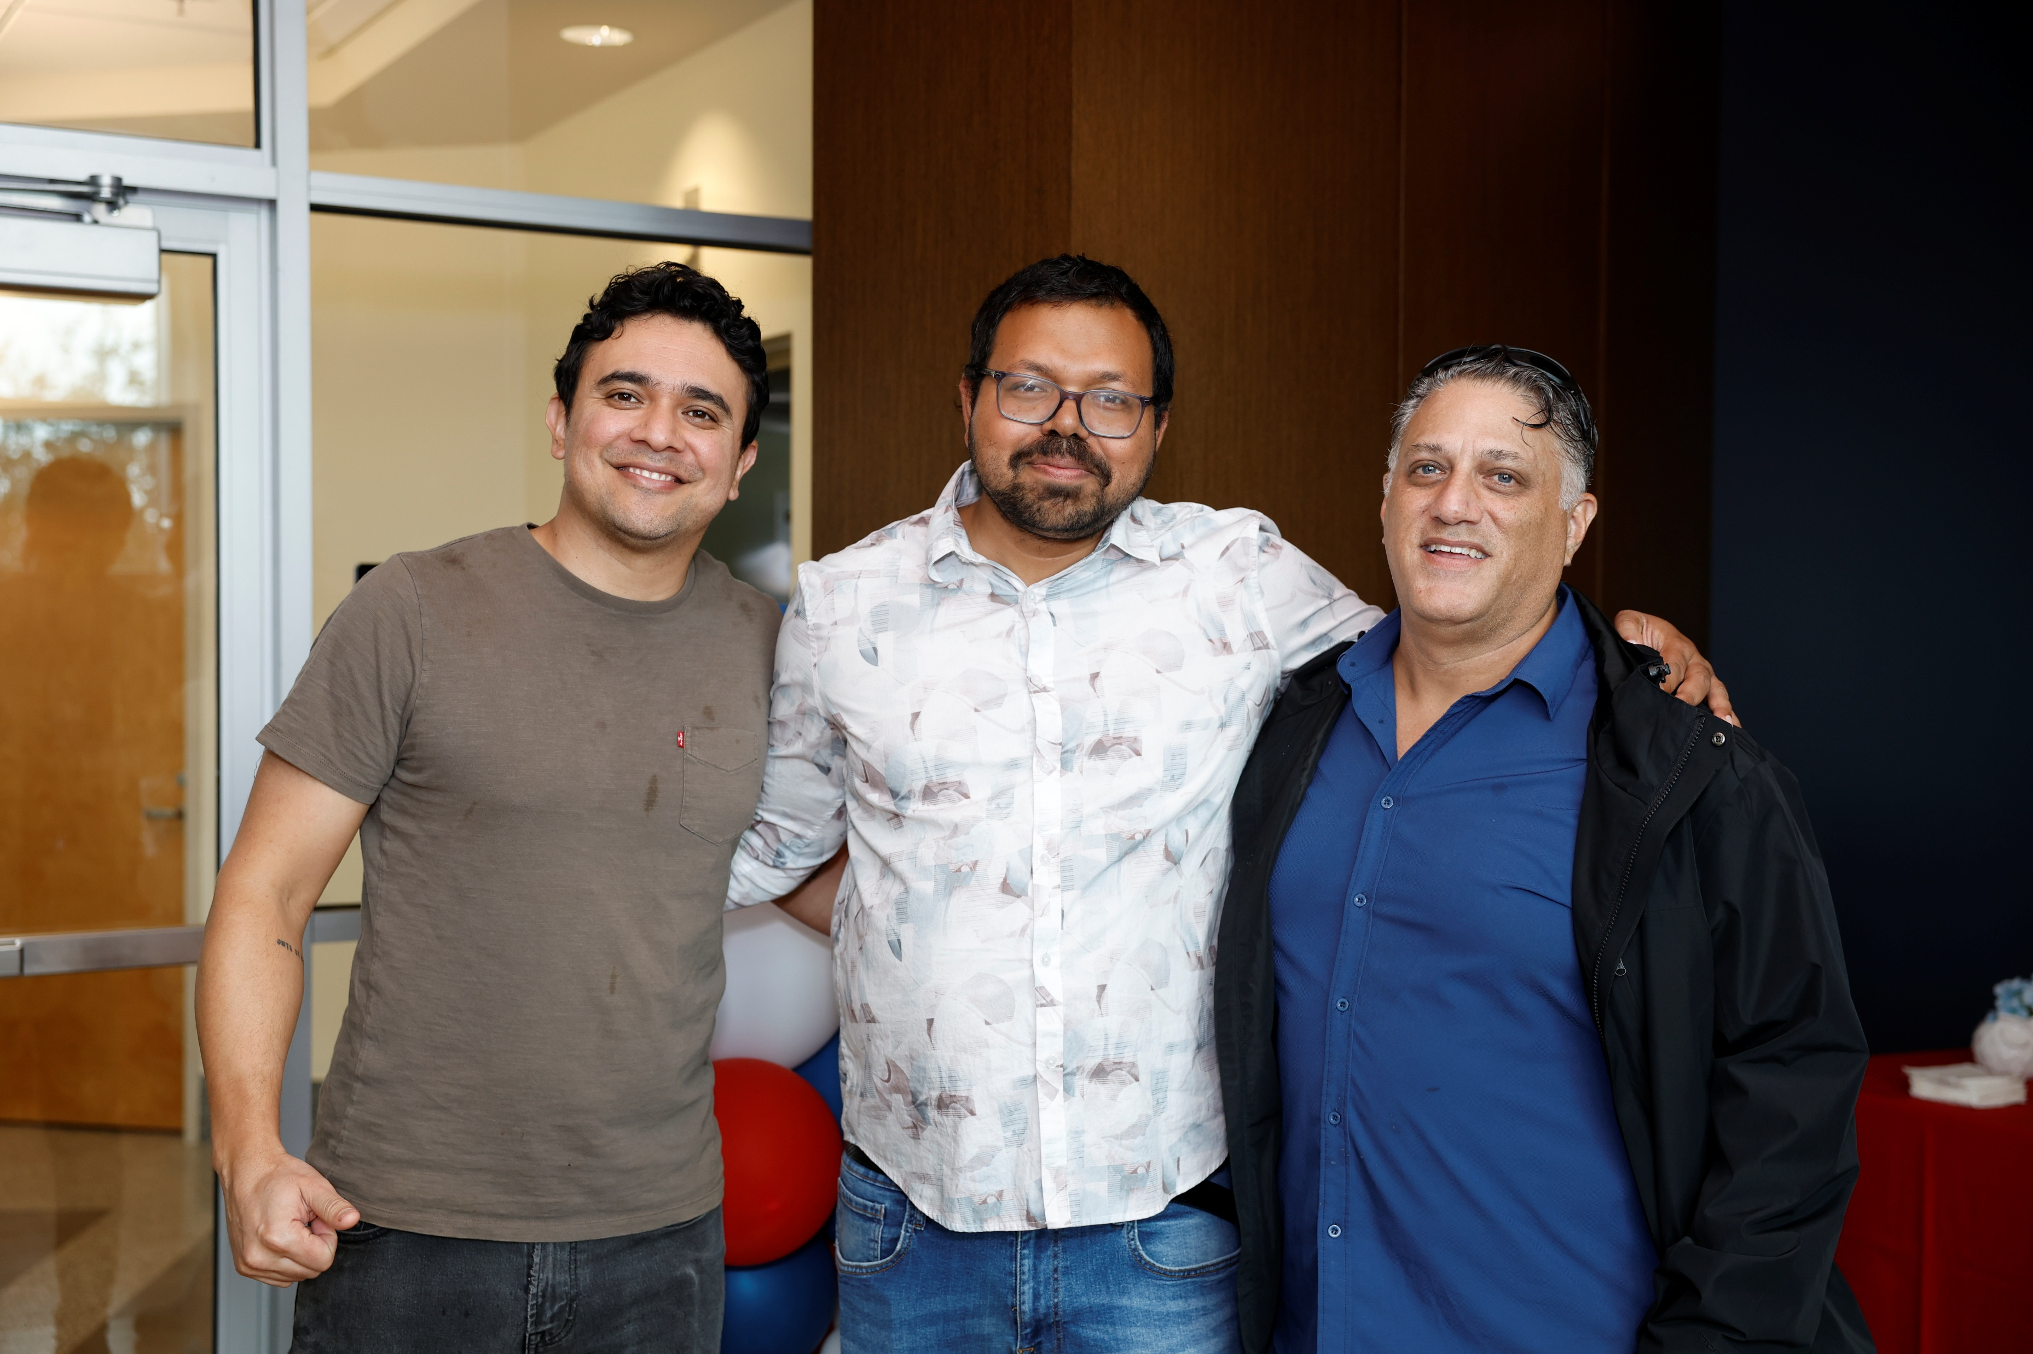
Subhosit Ray, President of Board and postdocs

Slide 7
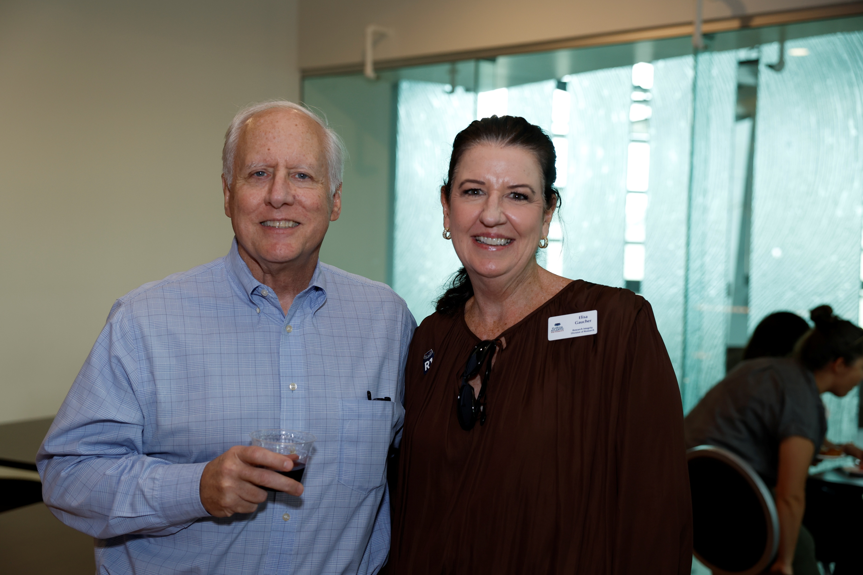
Dr. Randy Blakely and Elisa Gaucher

Slide 8
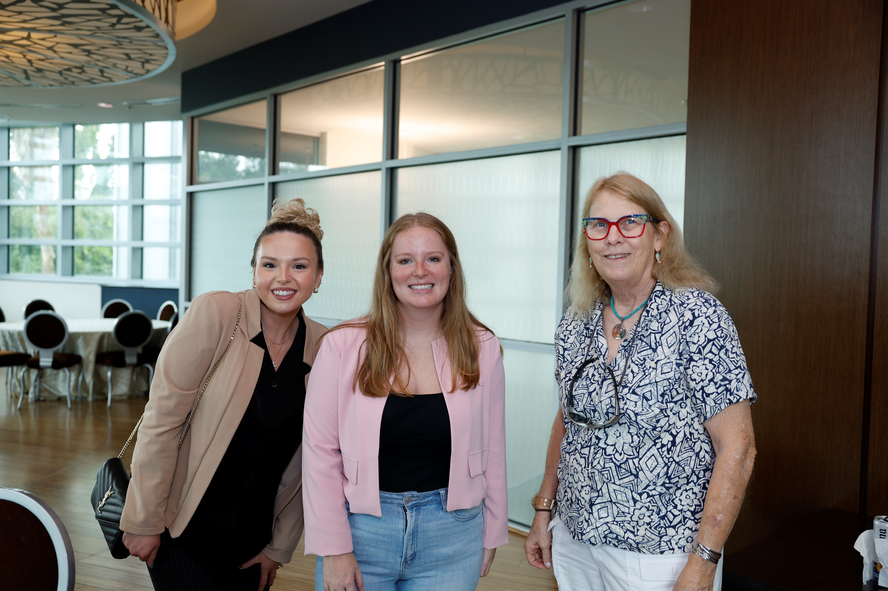
Jeannette Wyneken & Postdocs

Slide 9
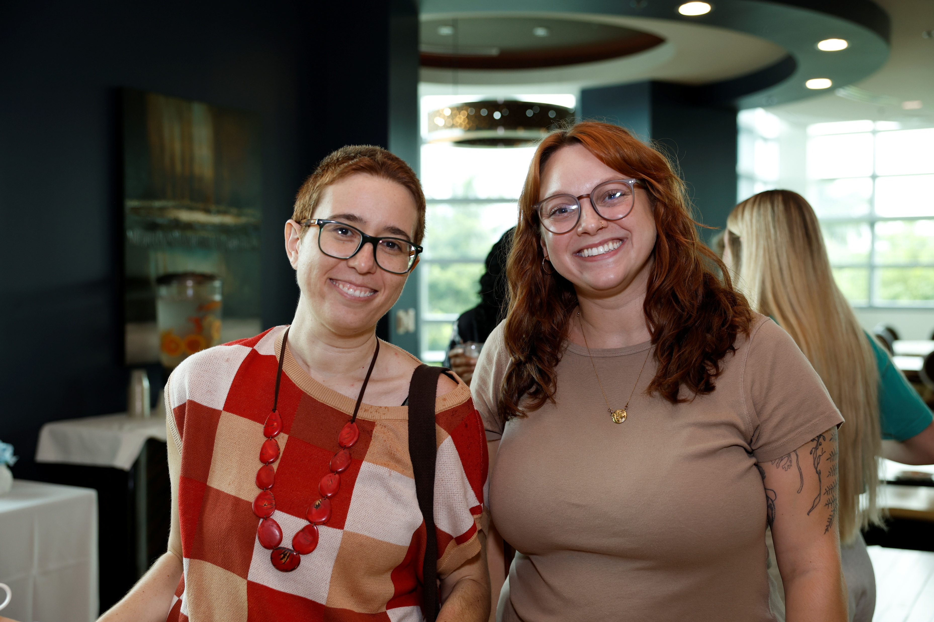
Postdocs

Slide 10
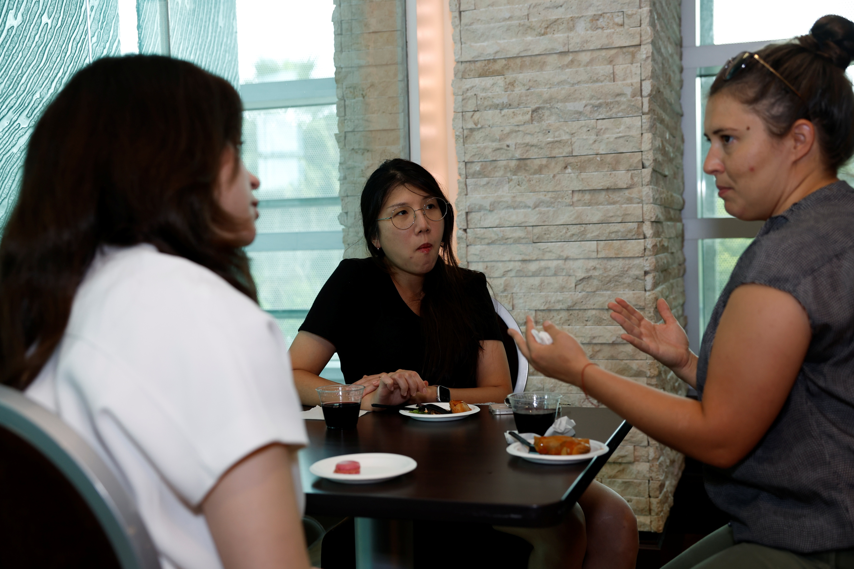
Postdoc networking

Slide 11
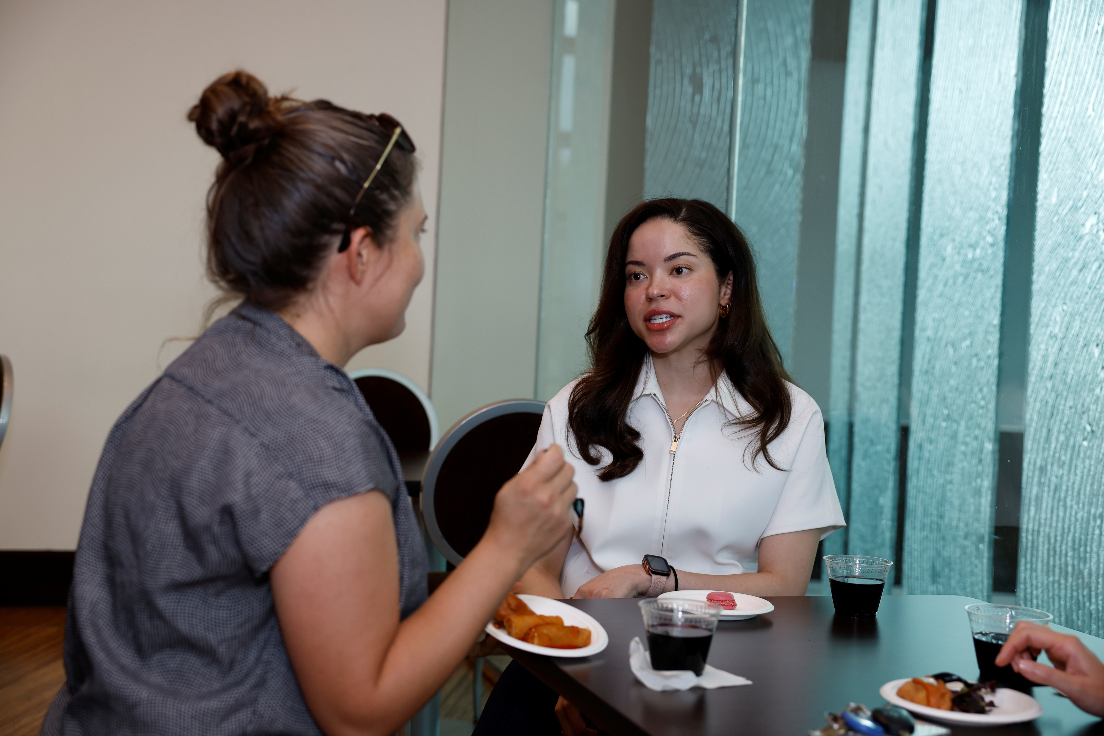
Postdocs convos

Slide 12
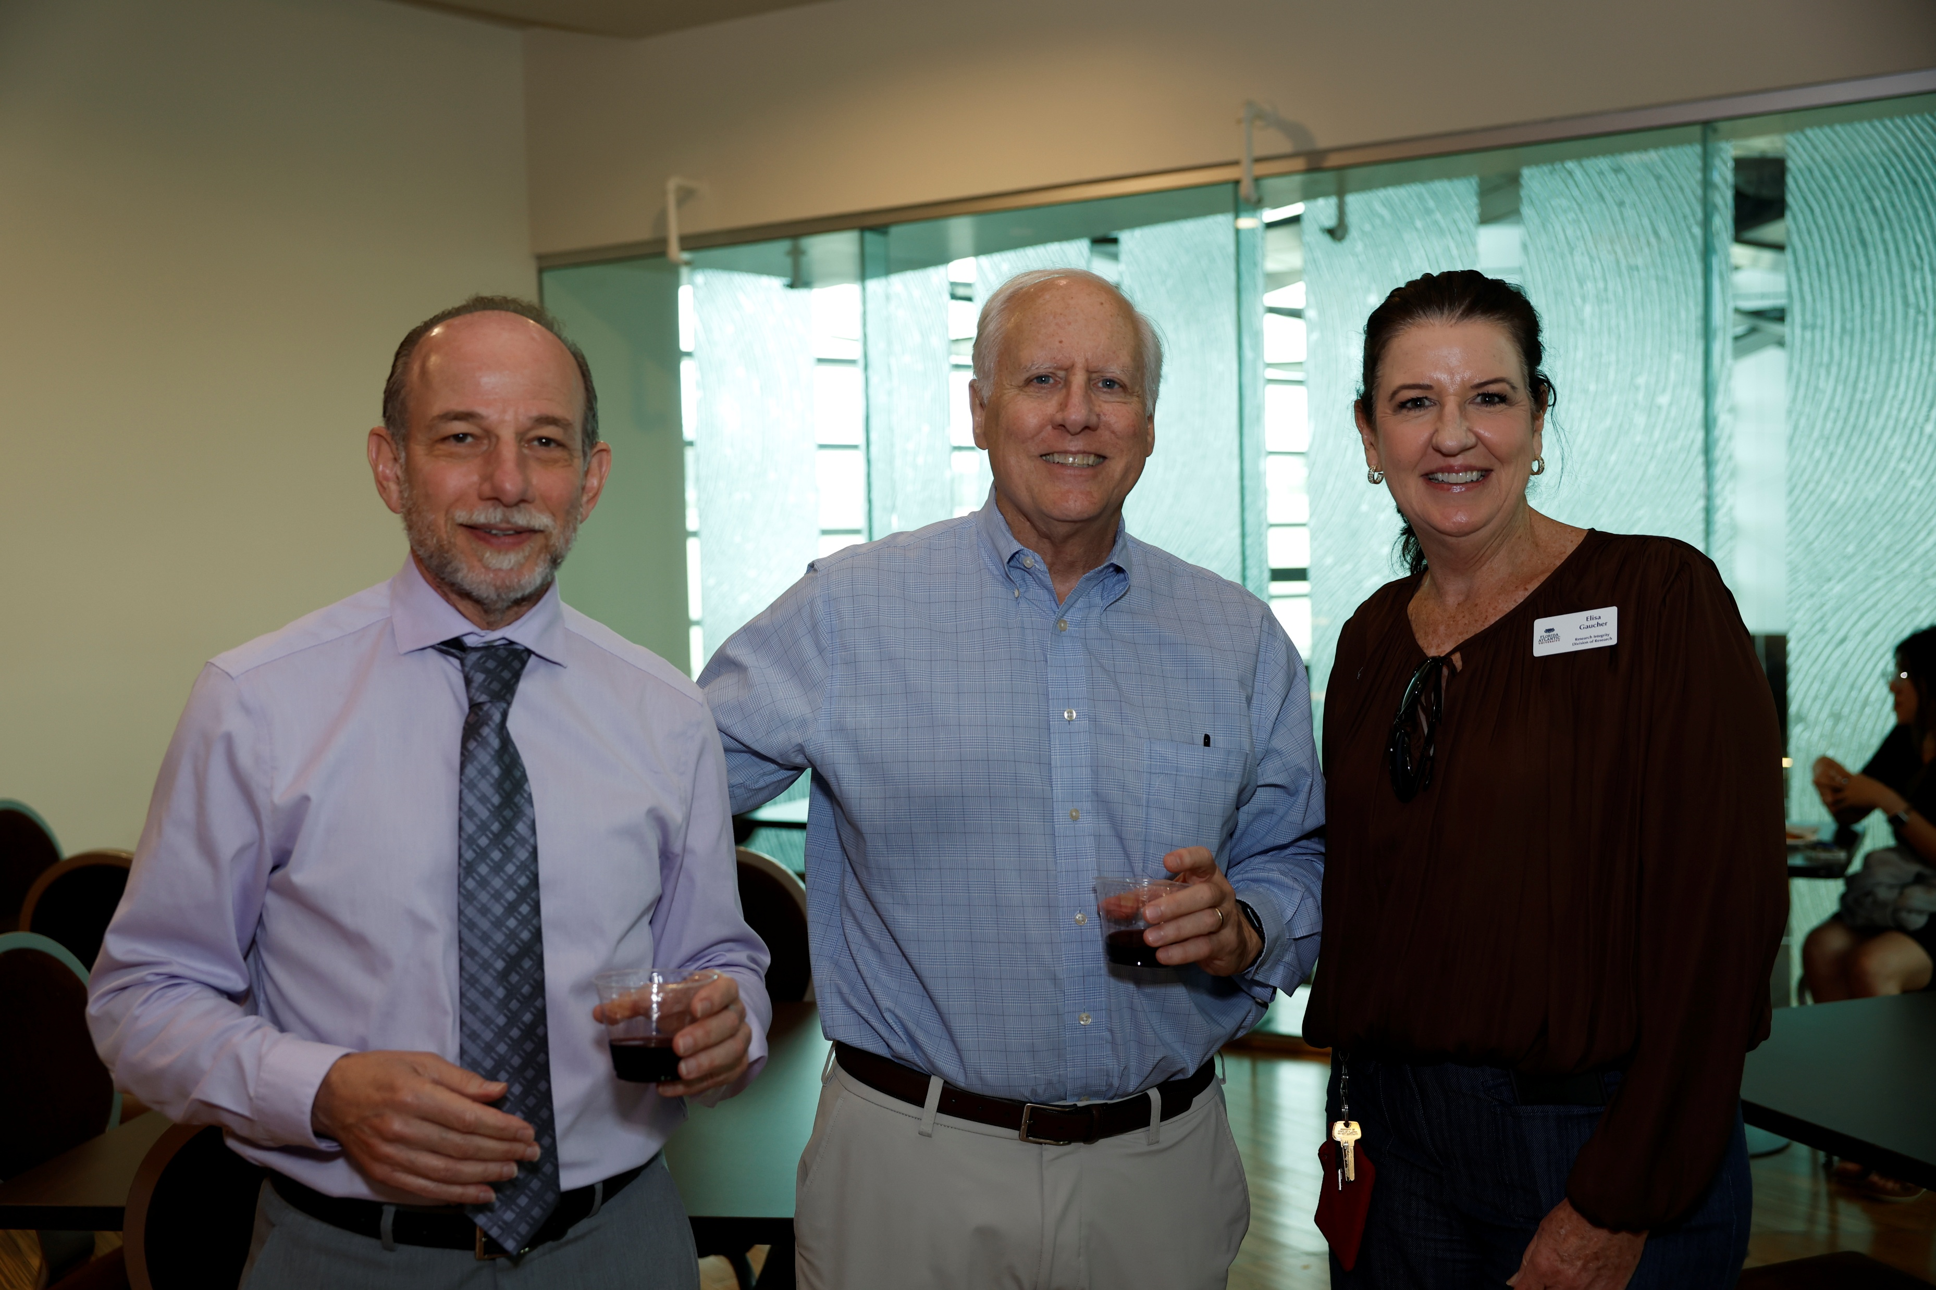
Dr. Fields, Dr. Blakely, Elisa Gaucher

Slide 13
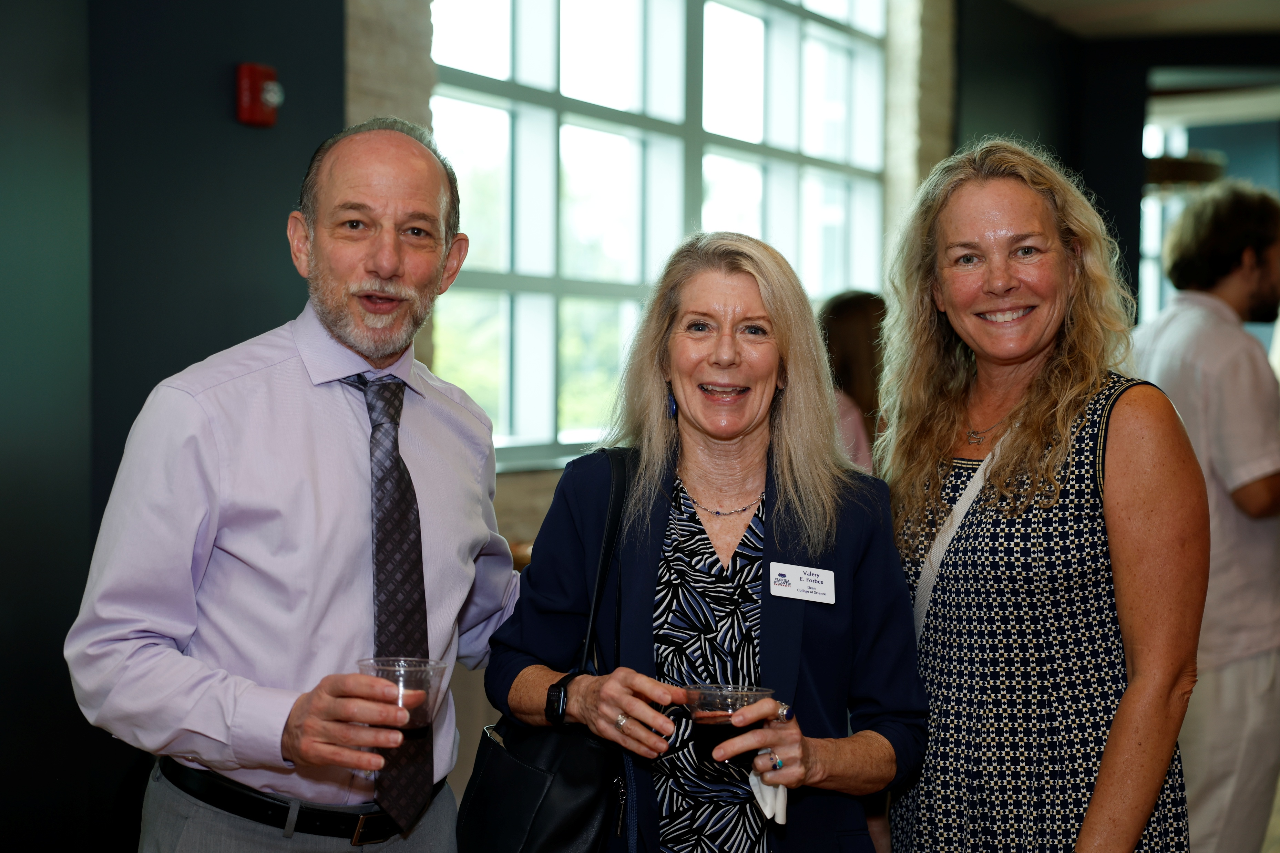
Dr. Fields, Dean Forbes, Dr. Krause-Parello

Slide 14
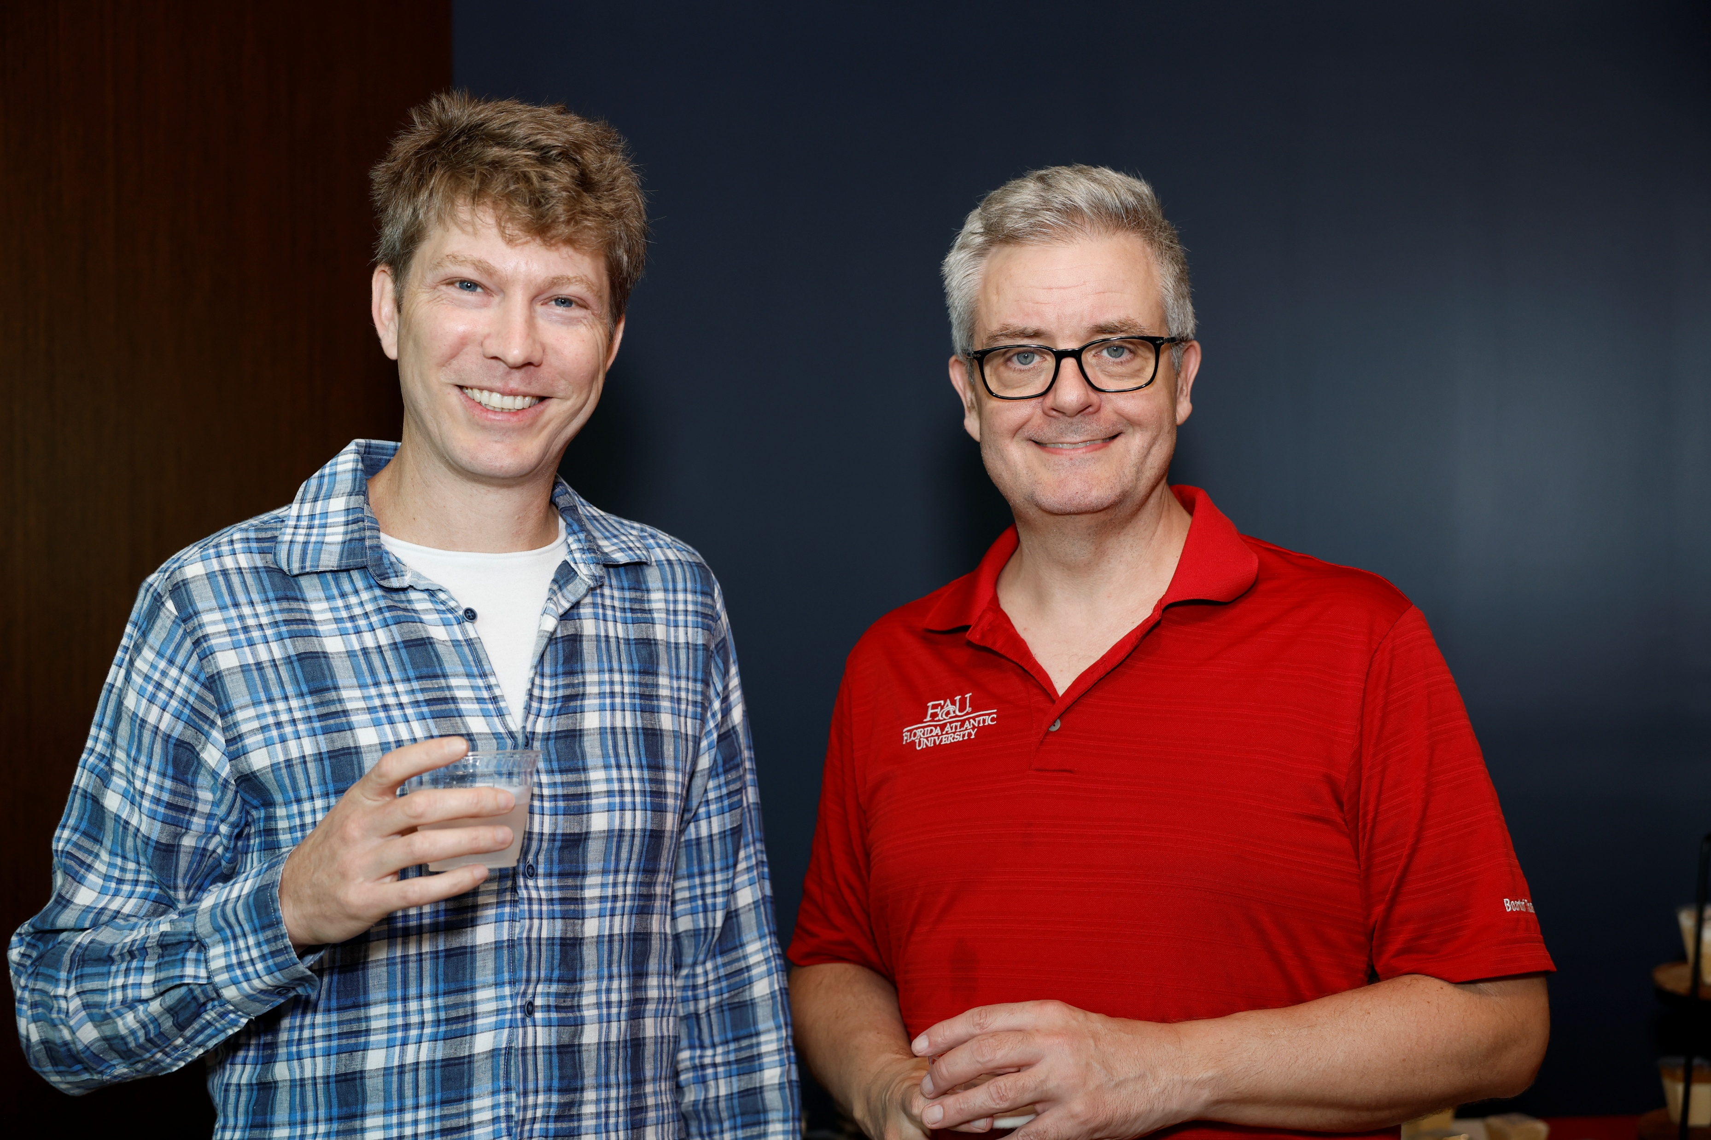
Postdoc and mentor

Slide 15
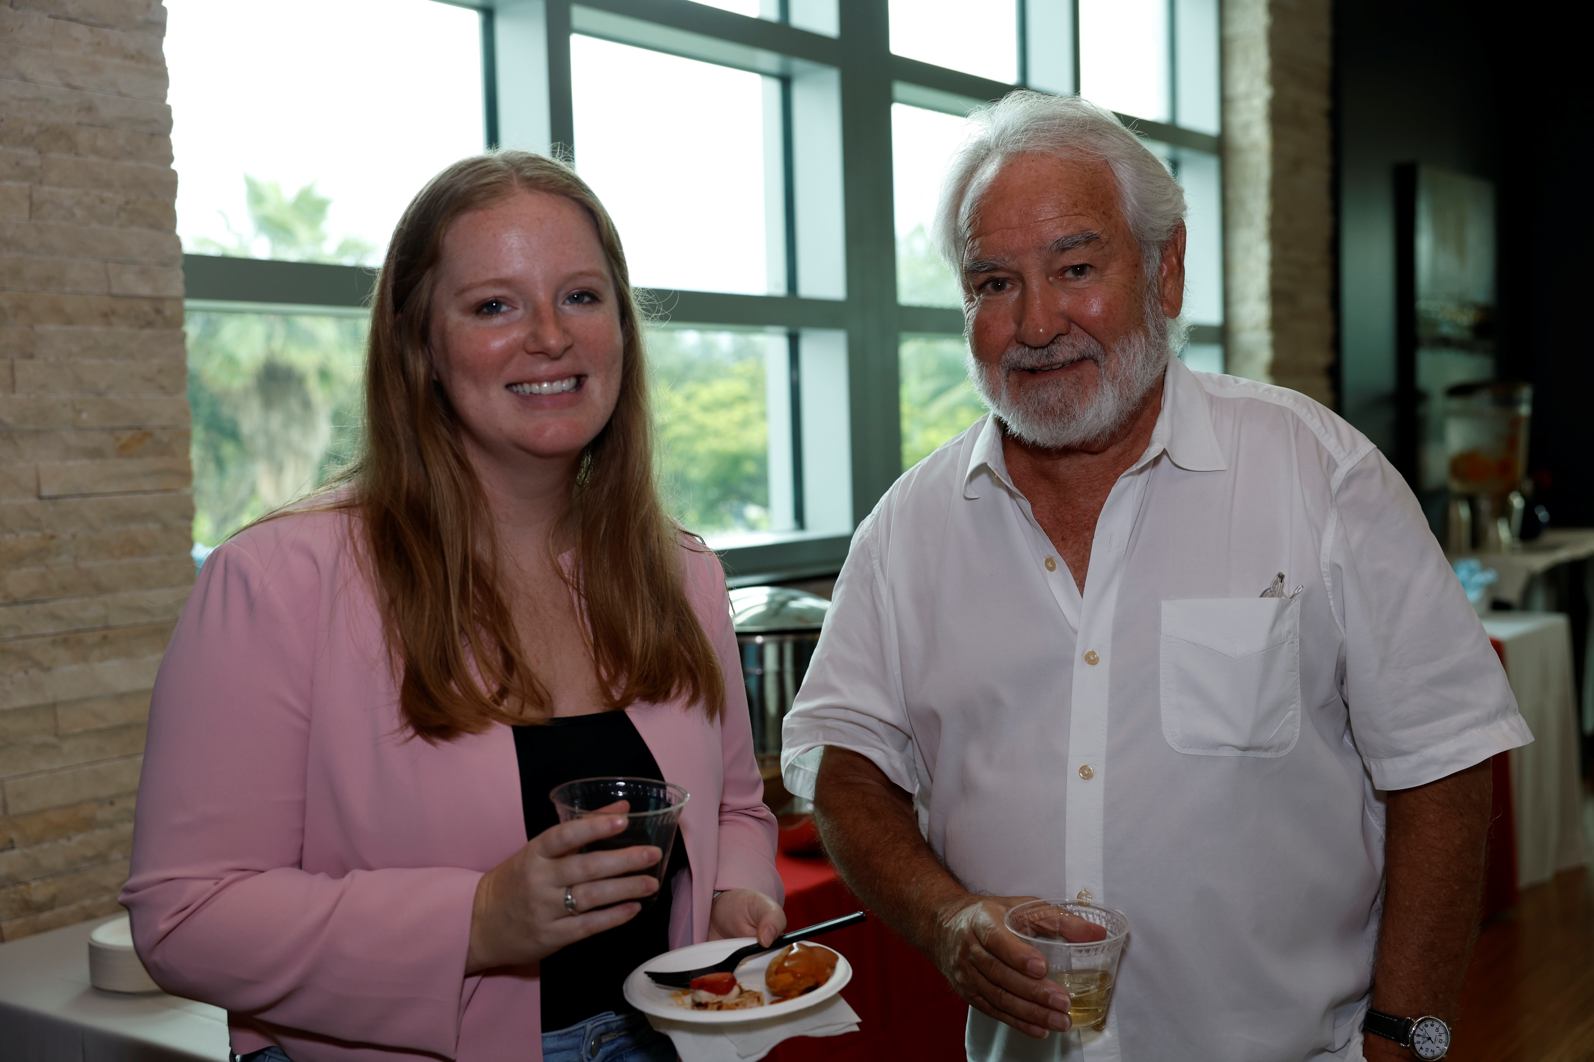
Dr. Kelso and postdoc: Smile and enjoy

Slide 16
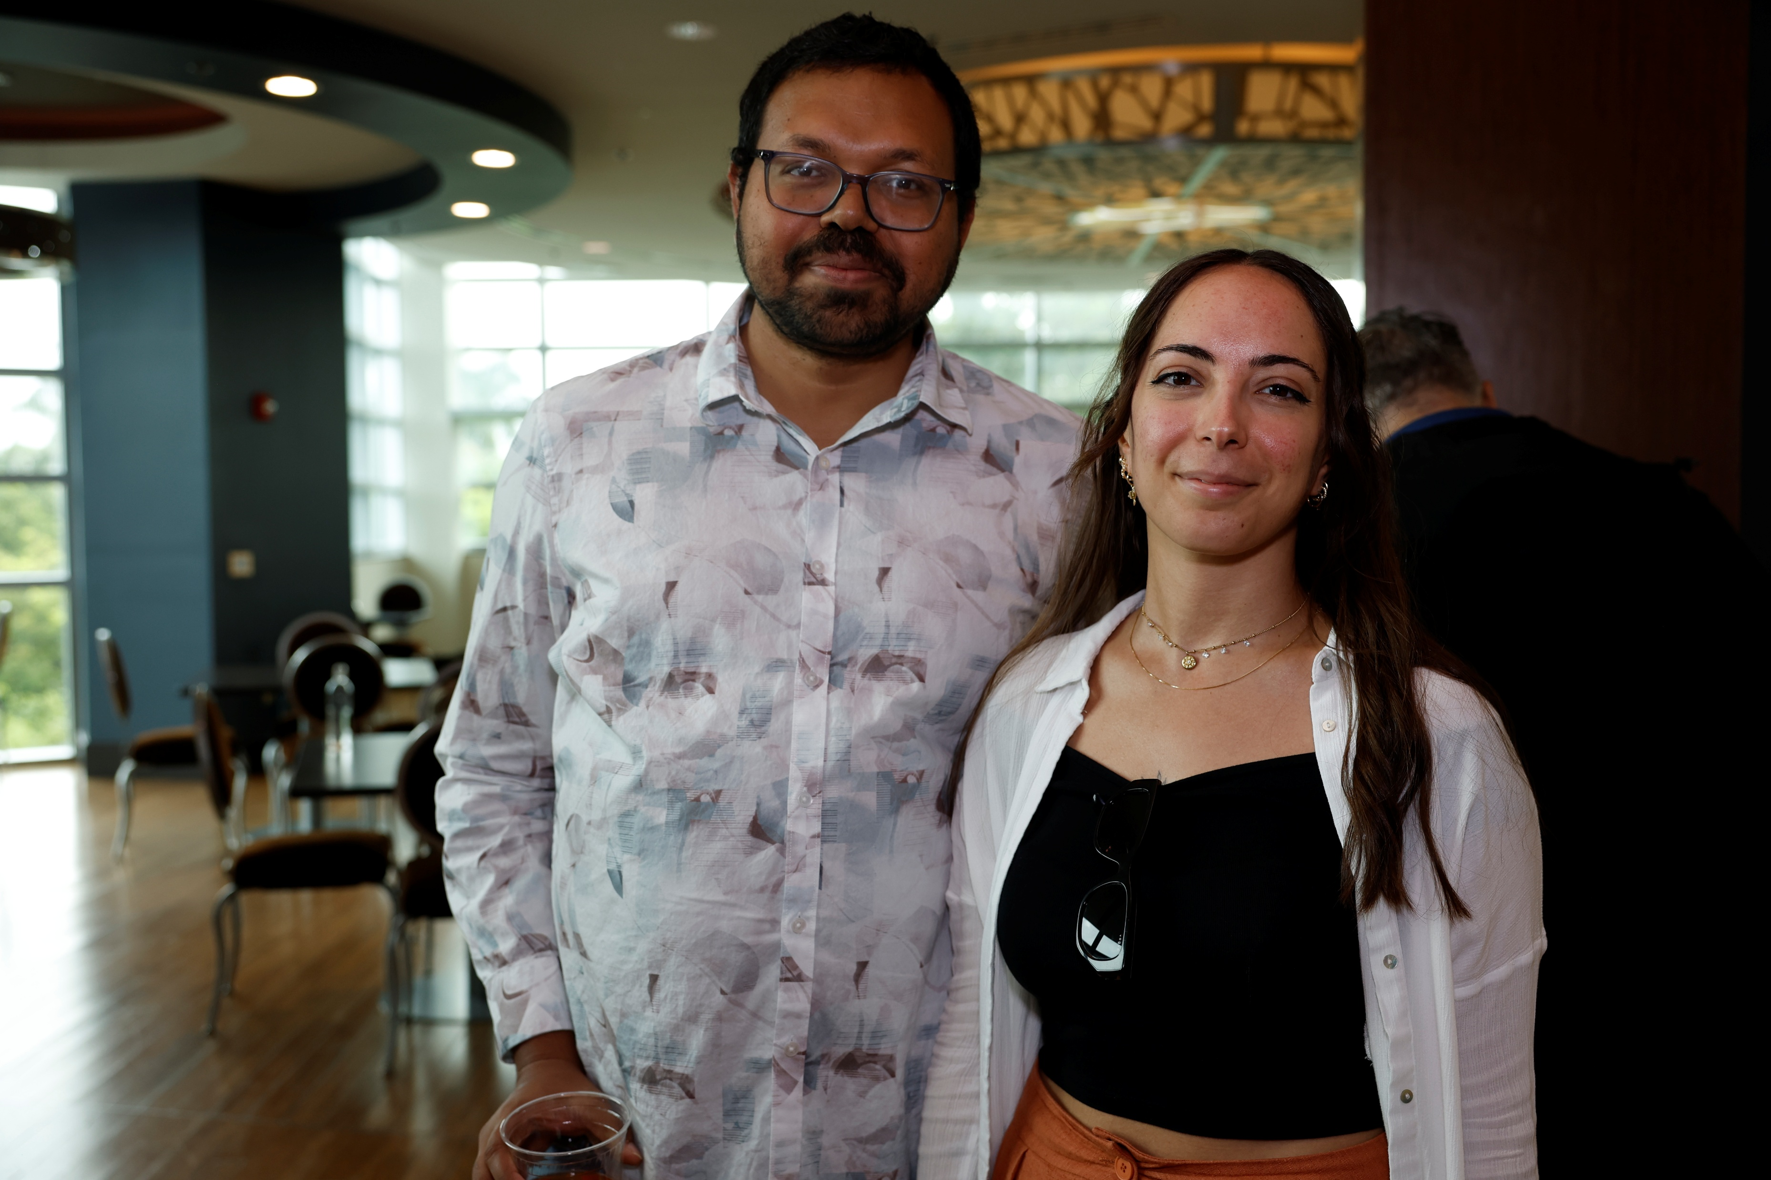
Subhosit Ray and postdoc

Slide 17
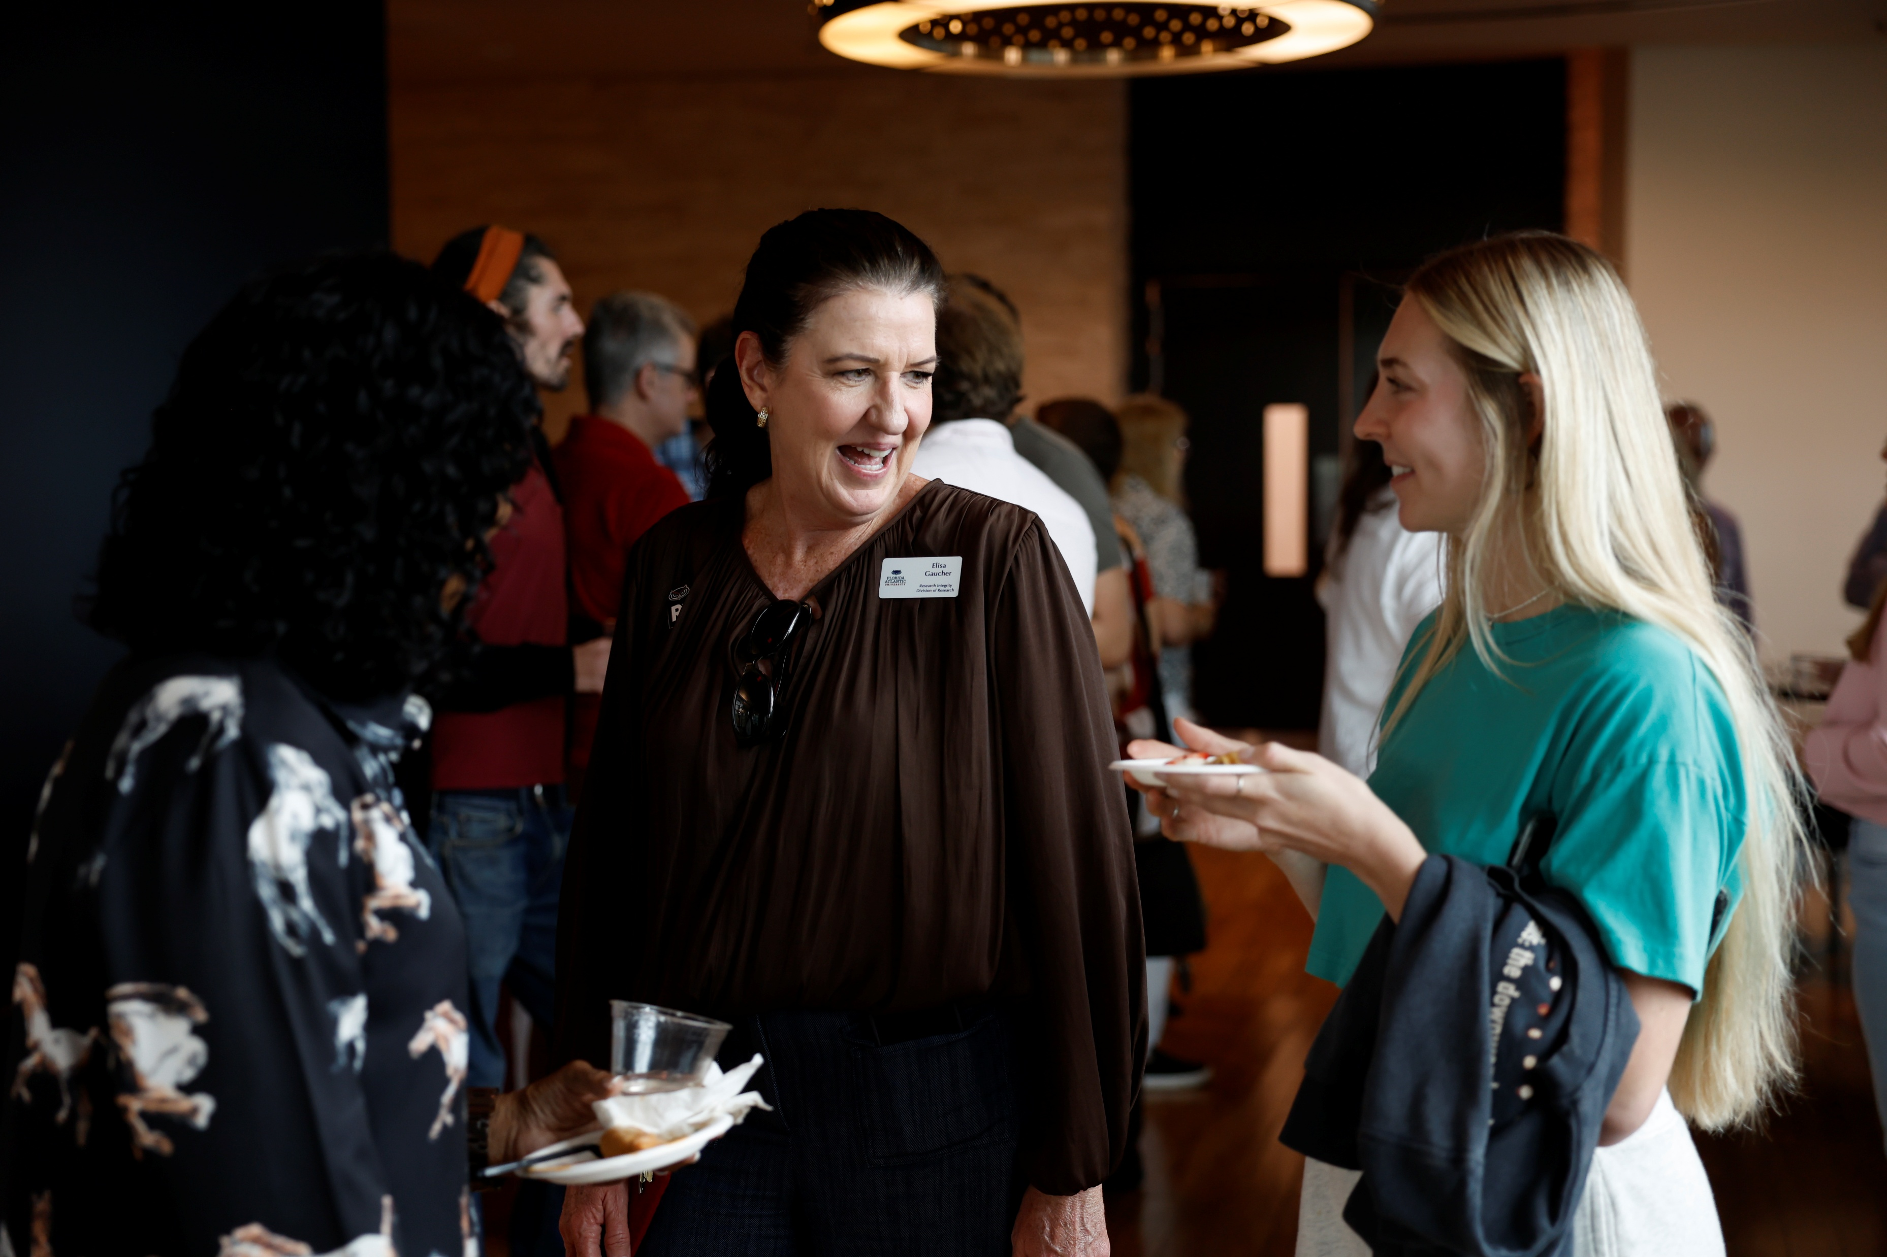
Chat and laughter

Slide 18
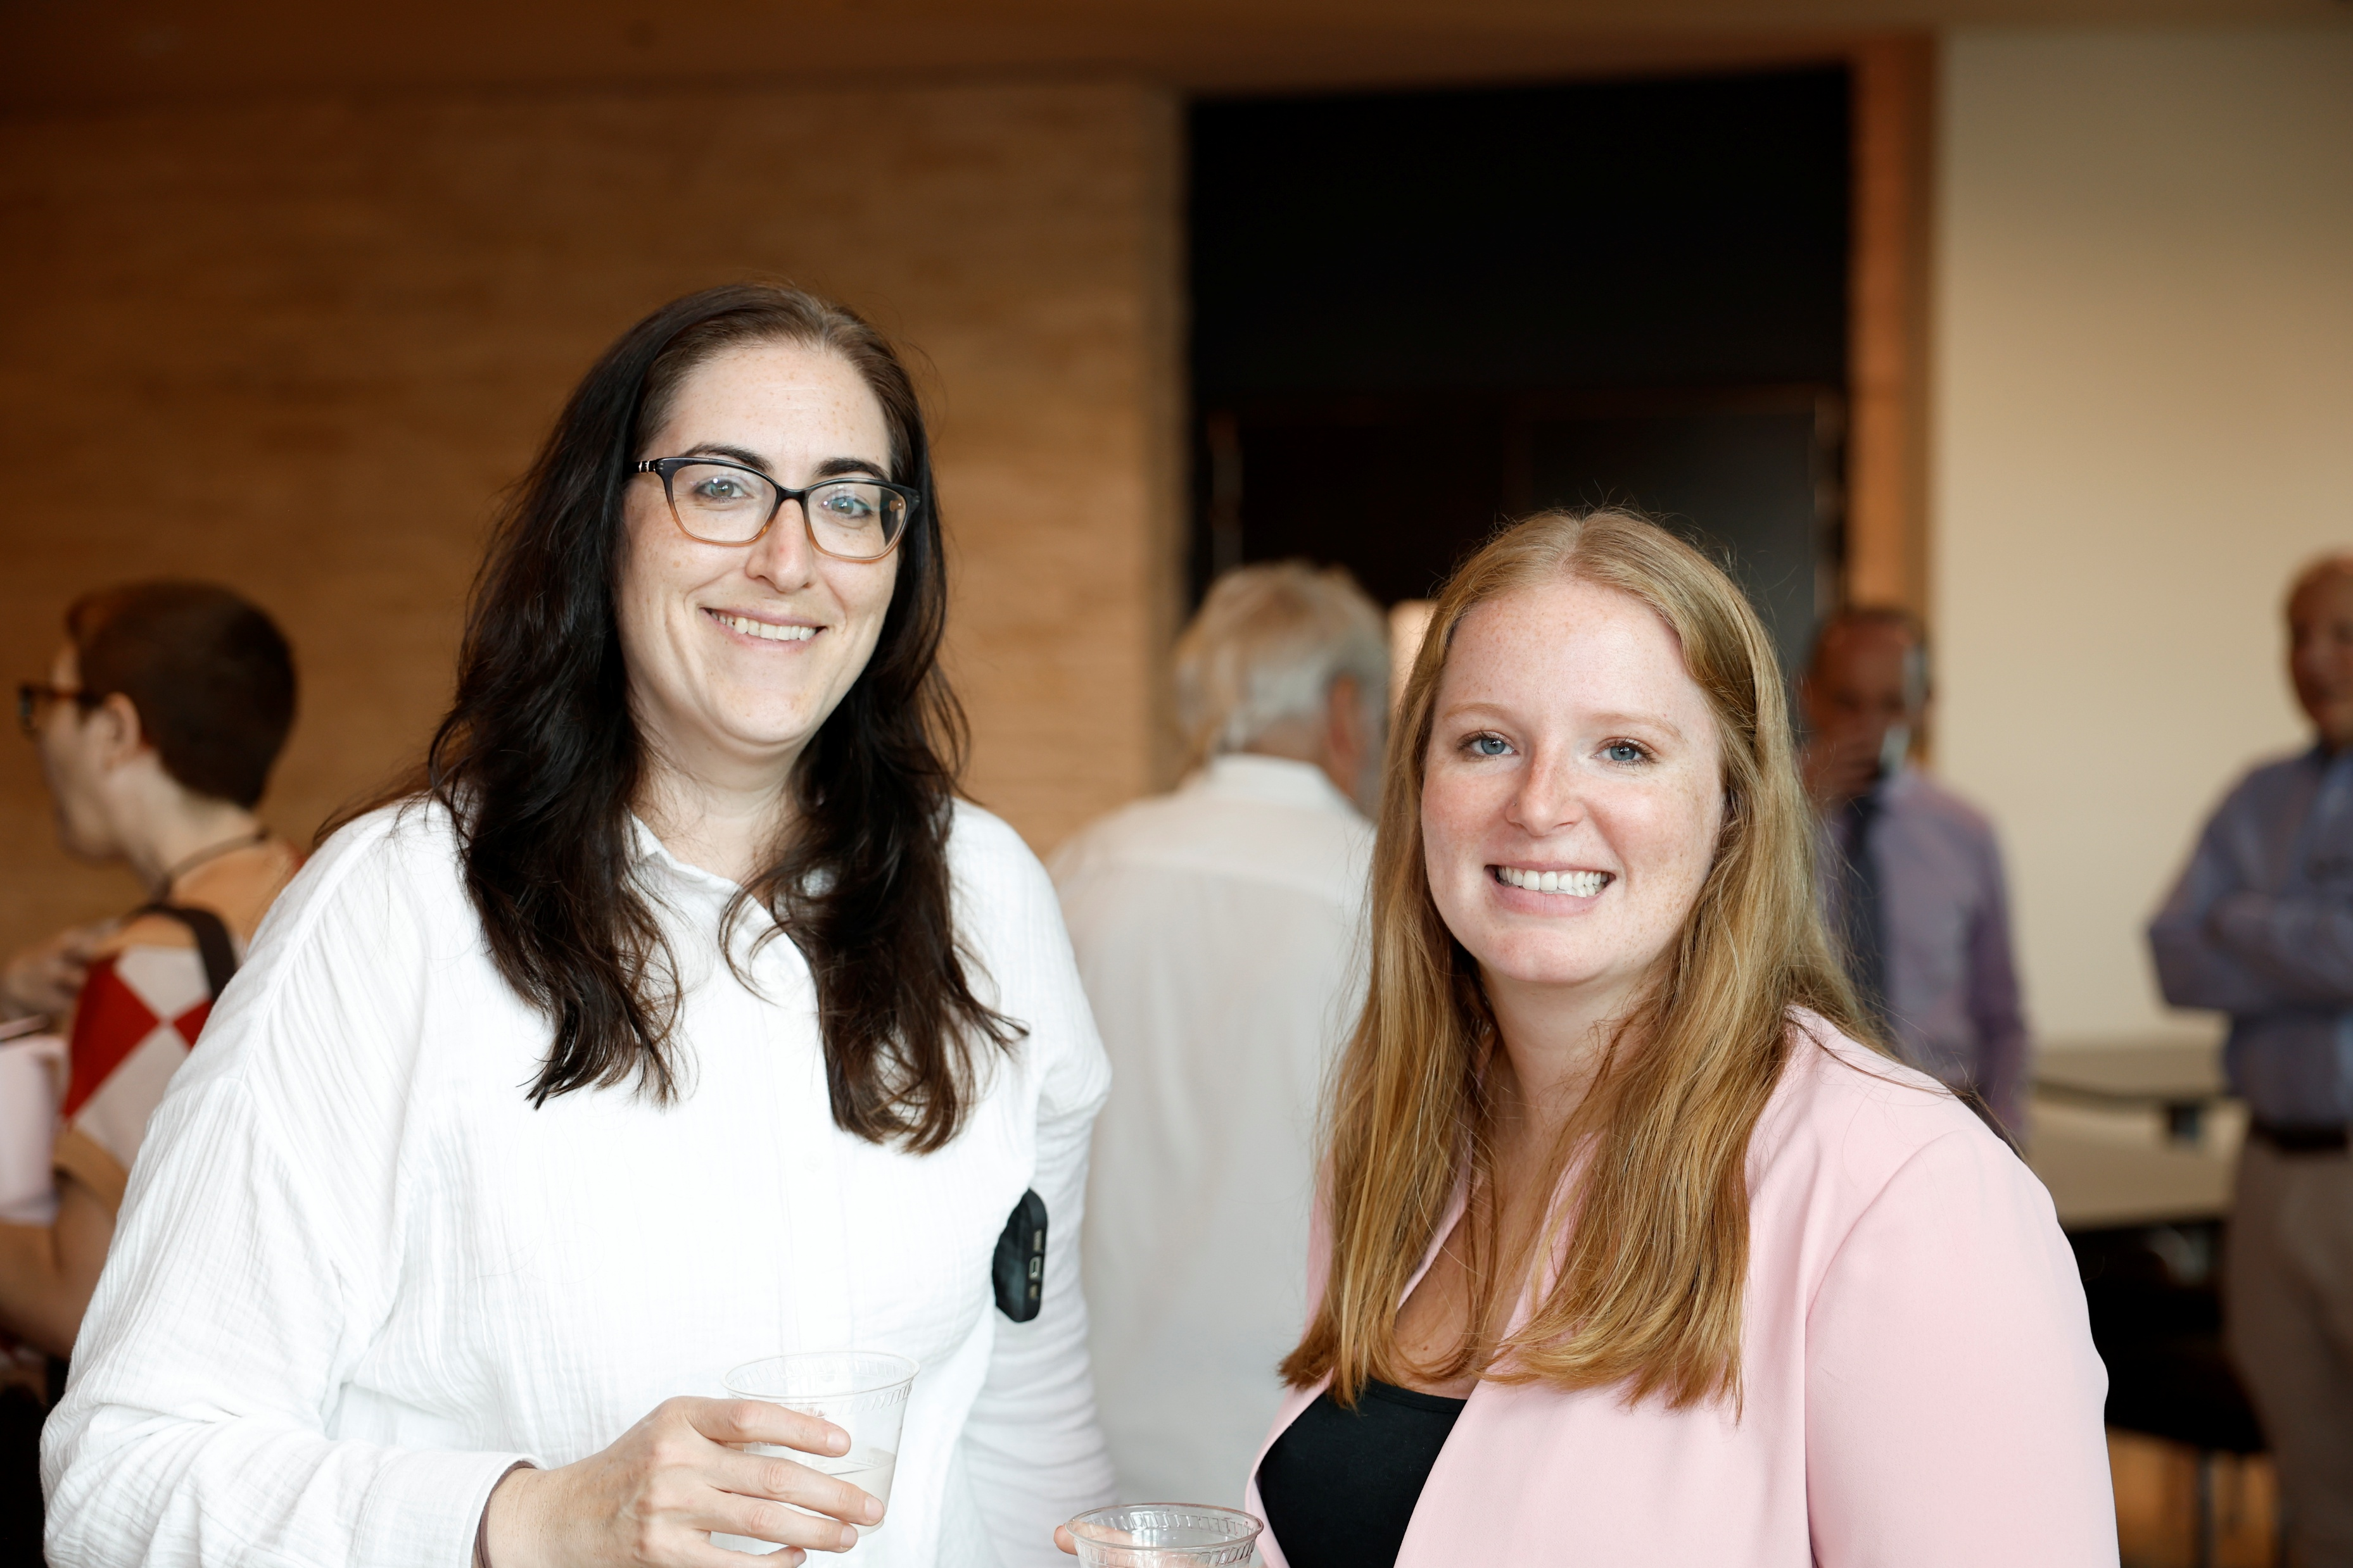
Networking

Slide 19
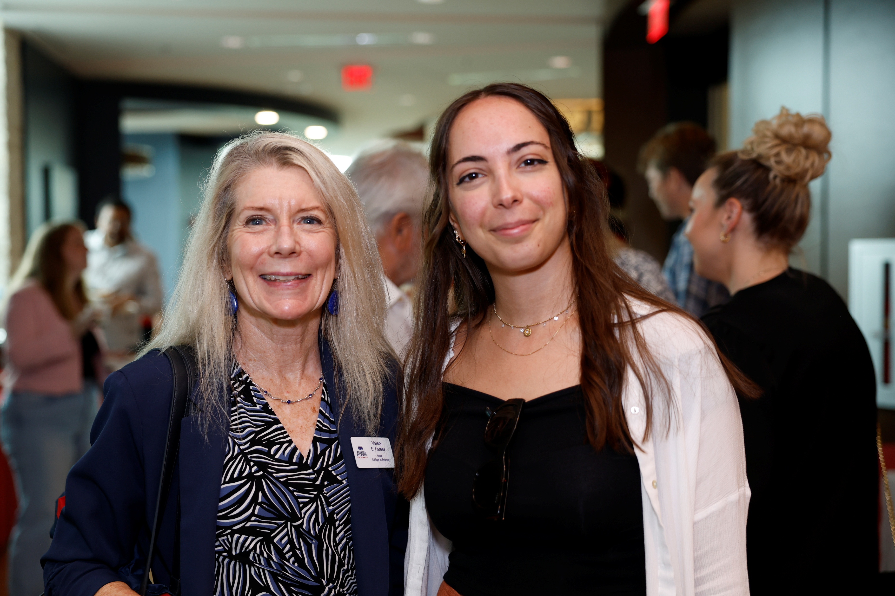
Dean Forbes, postdoc

Slide 20
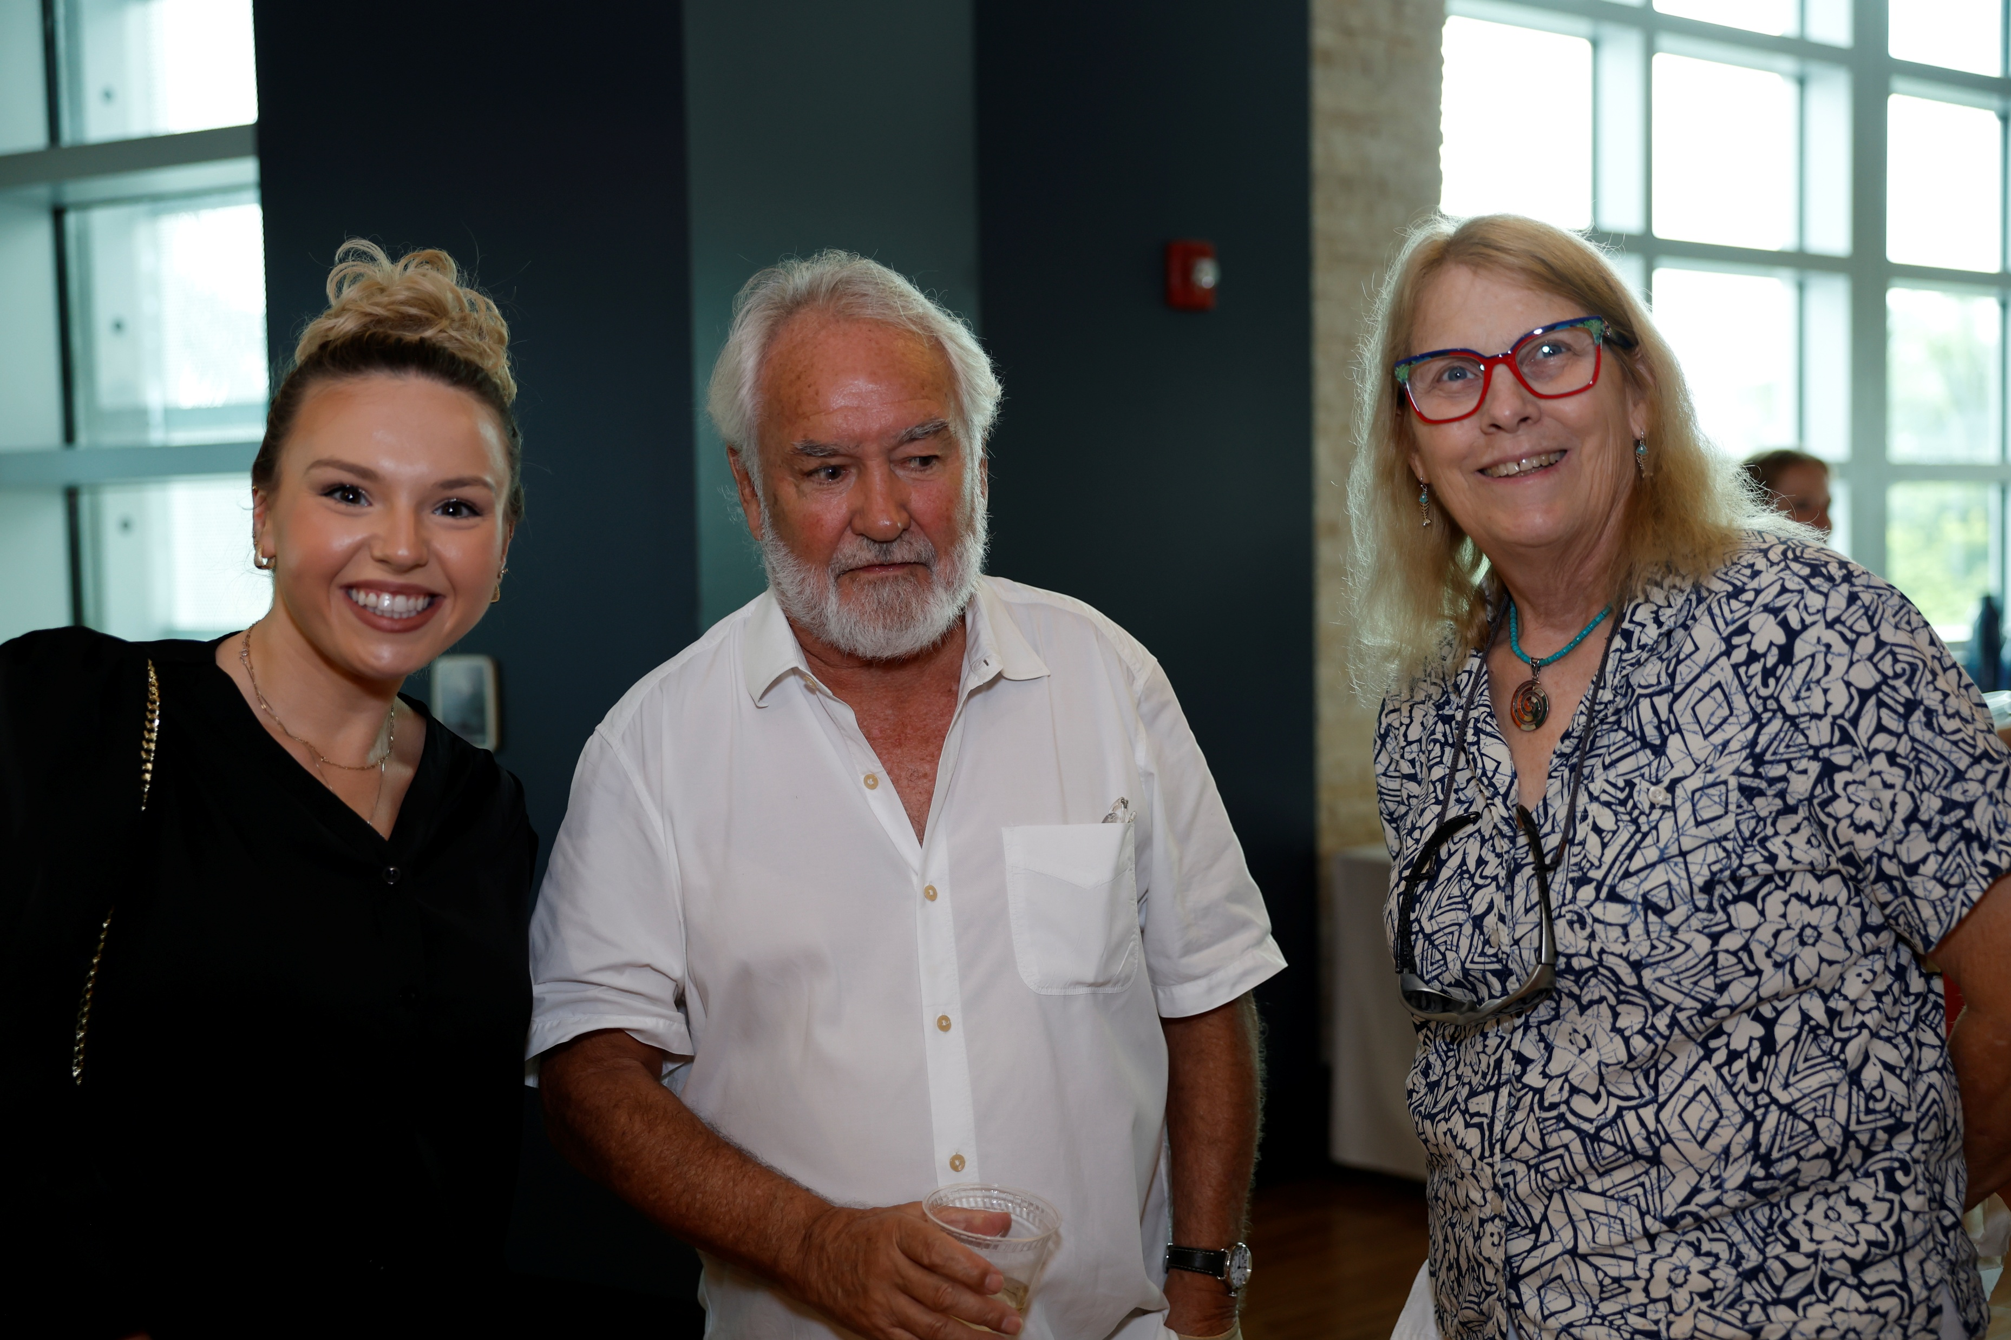
Dr. Kelso, Dr. Wyneken and postdoc

Slide 21
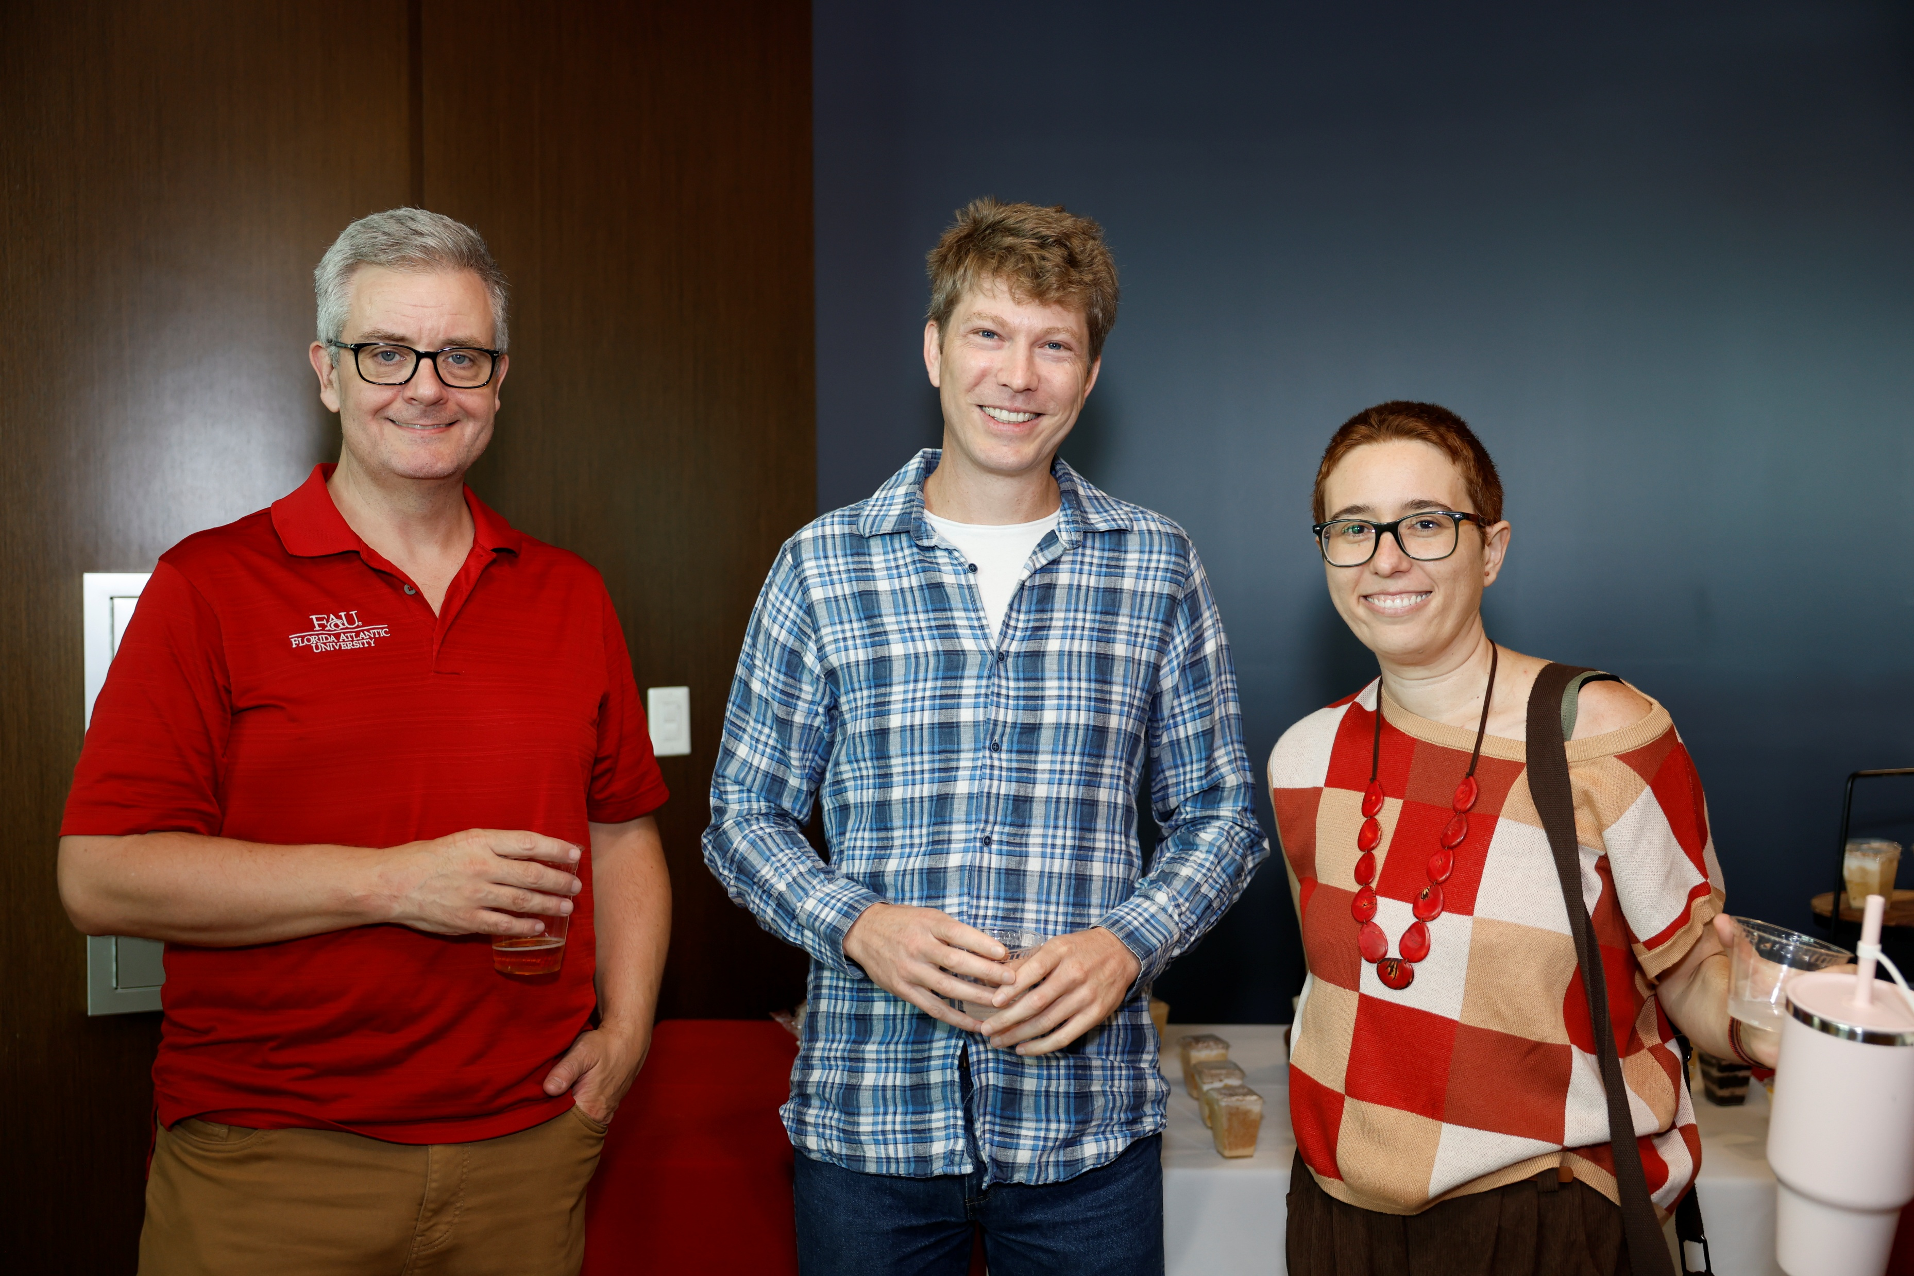
Mentor and postdocs

Slide 22
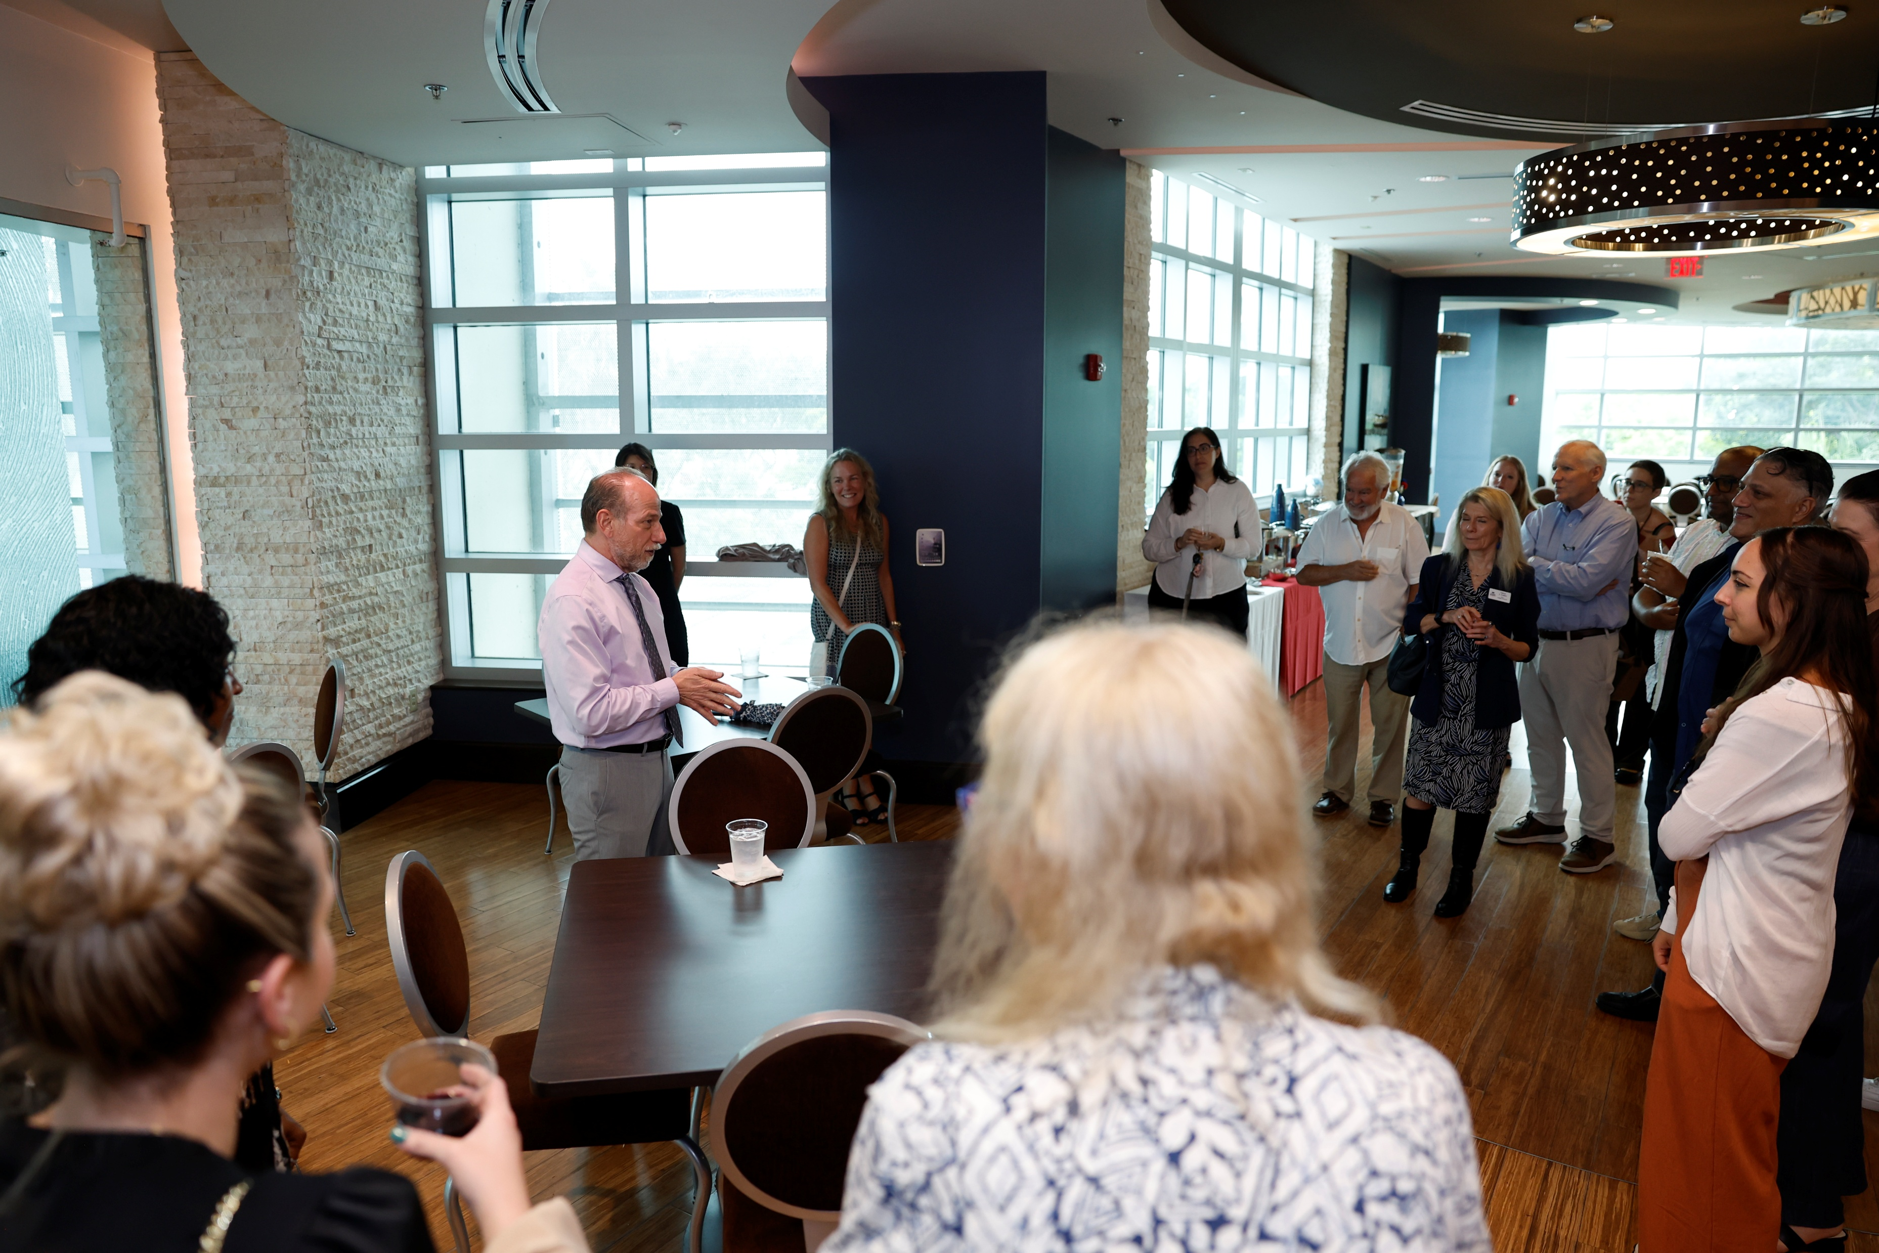
Welcoming words from Dr. Gregg Fields, VPR

Slide 23
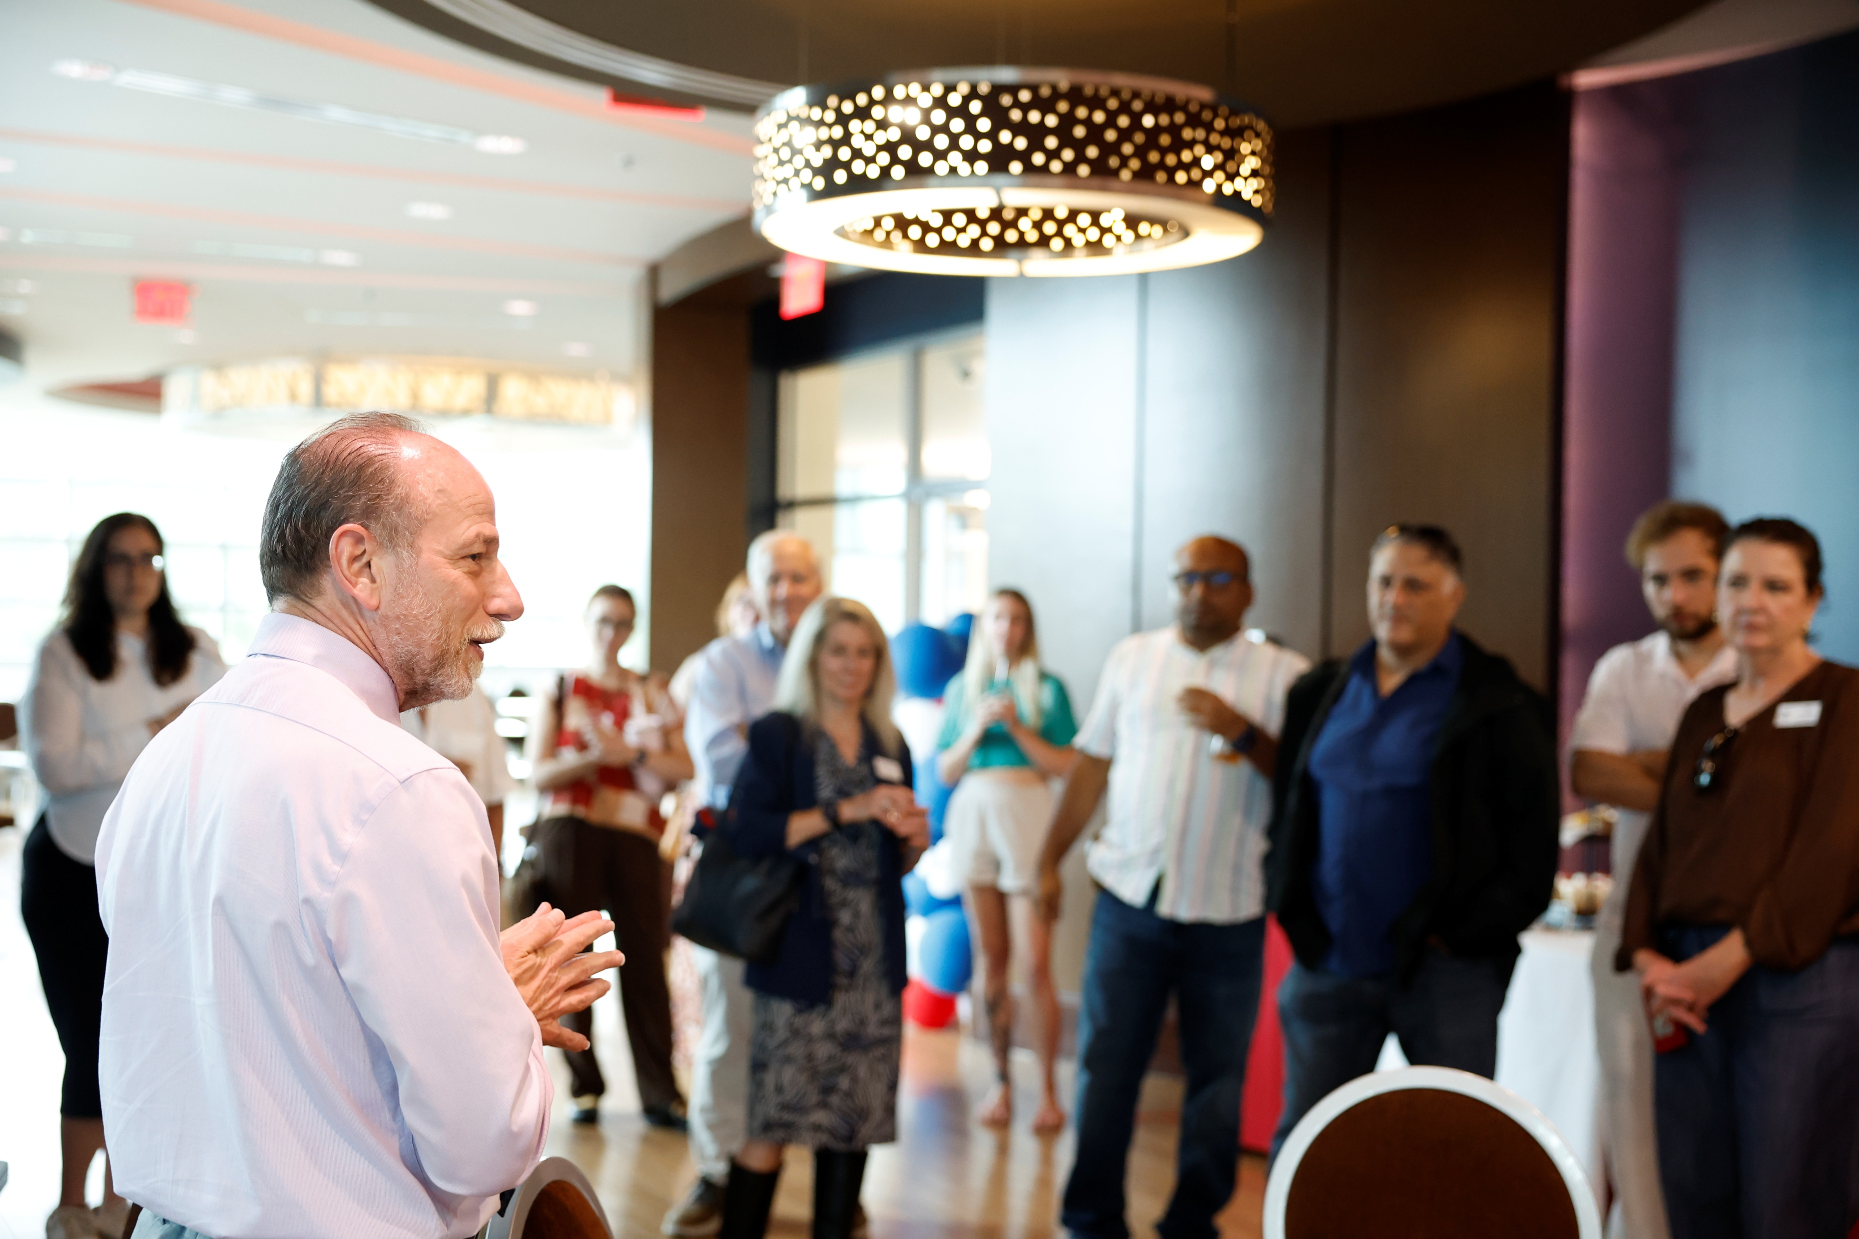
Welcoming remarks

Slide 24
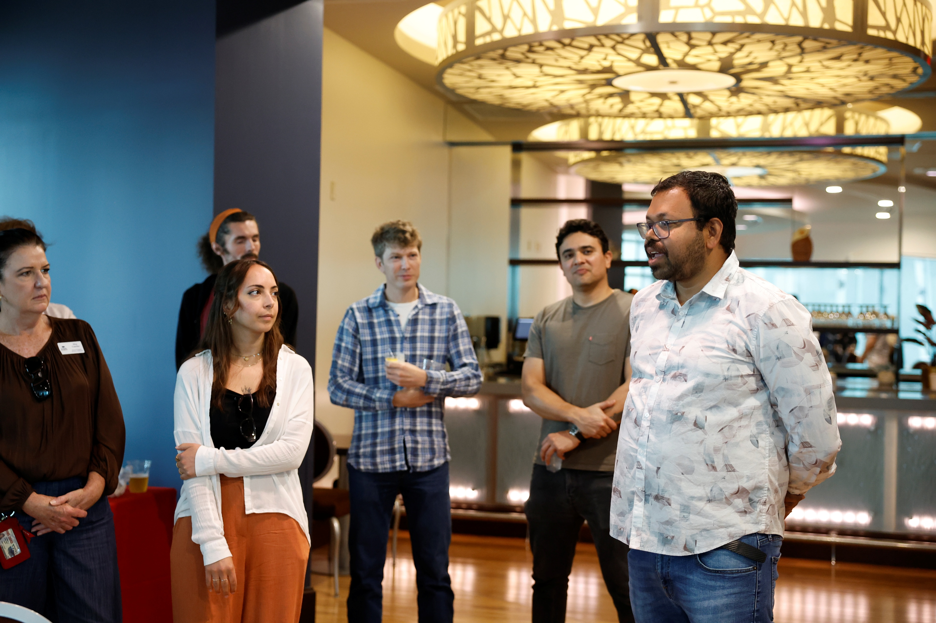
Remarks from Subhosit Ray

