Slide 1



Novelution
Ad Hoc Reports & CSV Files
Presented by: The Office of Sponsored Programs

Slide 2

Ad Hoc Reports in
Novelution
Ad Hoc Reports in Novelution
Ad hoc reporting is a business intelligence process used to quickly create reports on an as-needed basis
Novelution’s robust Sponsored Research module captures key data points that can be extracted utilizing the ad hoc report function. Novelution’s ad hoc report function is based on specific filters or the combination of filters that are customizable by the user
Key Benefits
Flexibility – Users can choose the data points they want to work with
Speed - Data access is based on the user’s roles and running a report does not require going through IT or the Office of Sponsored Programs
Empowers Faculty/Staff – Empowers users to access and report findings as needed
Encourage Collaboration – Encourages collaboration by the ease of report creation and the ability to share them with other teams

Slide 3
Ad Hoc Reports Date
Range
Proposal Period Data
Reports for proposal related inquiries are only available from 07/01/2020 and on. Since the proposal module in Novelution initially launched on 07/01/2020, only proposals entered on or after this date is captured in Novelution
Any proposal report inquiry prior to 07/01/2020 must be generated through grantsERA
Award Period Data
Reports for award related inquires are only available from 07/01/2021 and on. Since the award module in Novelution initially launched on 07/01/2021, only awards entered on or after this date is captured in Novelution
Any award report inquiry prior to 07/01/2021 must be generated through grantsERA

Slide 4
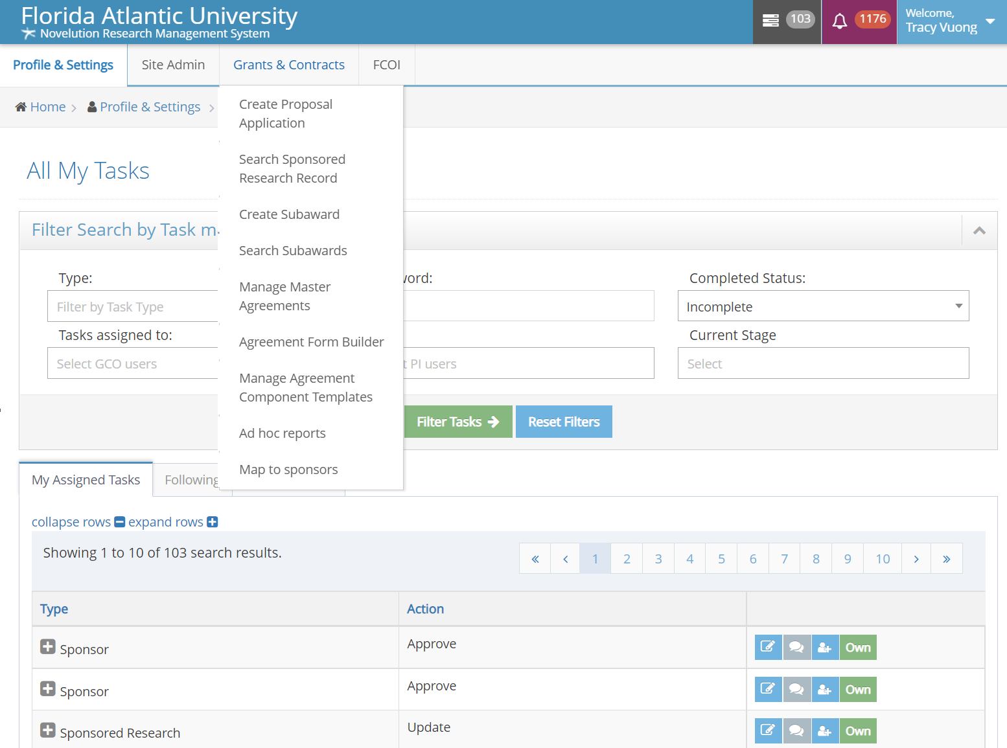
Novelution’s Ad Hoc Reports Interface & How to Navigate
1) The Ad hoc reports section is located under Grants& Contract tab
2) Select Ad hoc reports

Slide 5
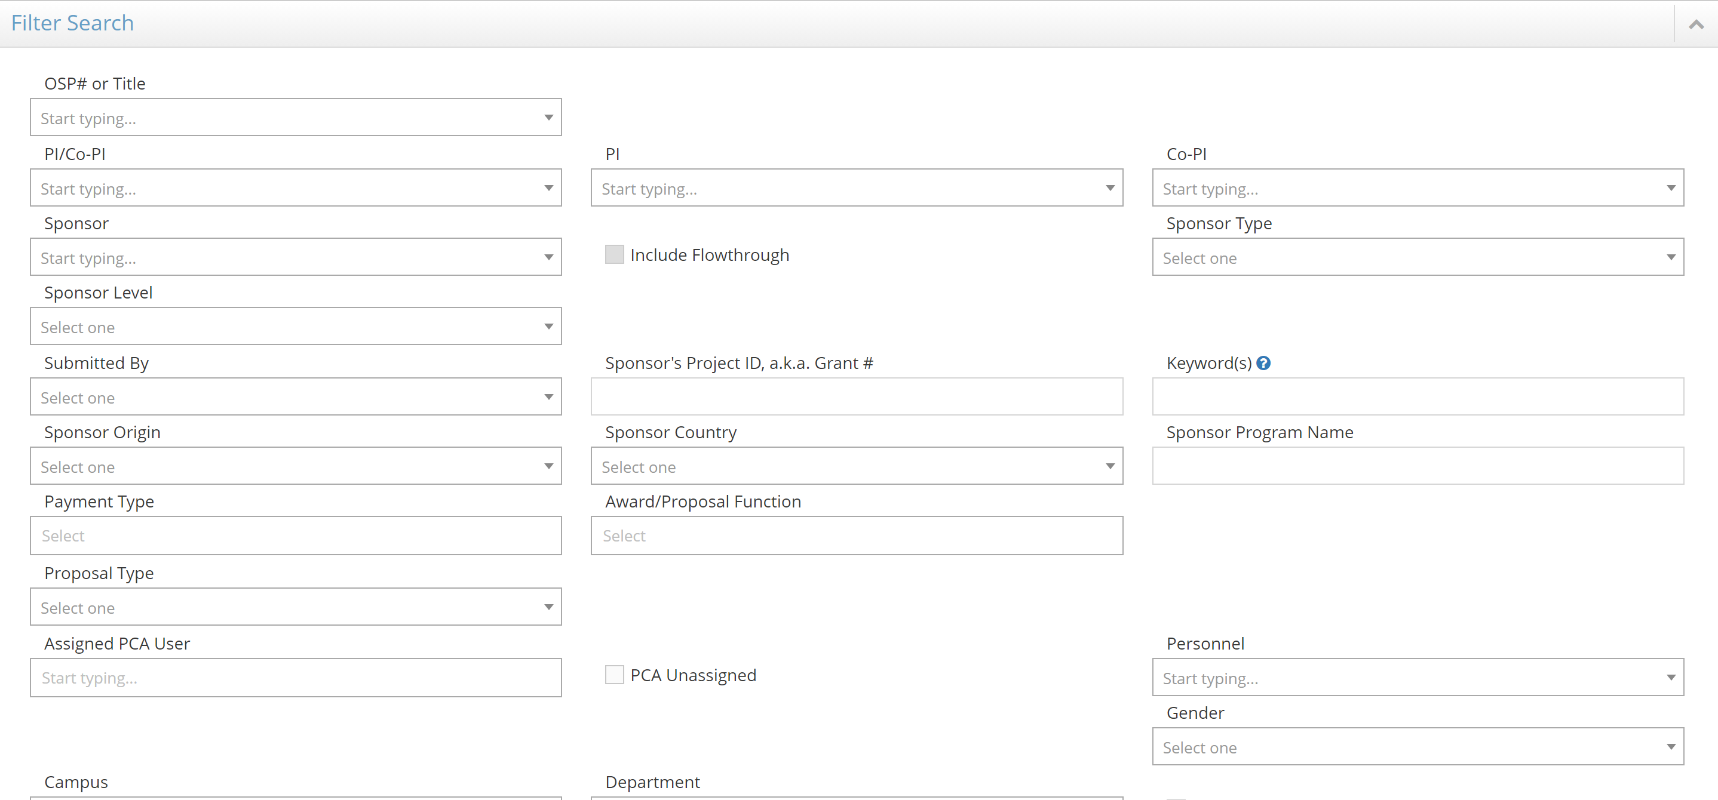
Ad hoc Reports Filters and Selections
Filter Search
The “Filter Search” panel allows users to select the search parameters to fits their needs
Users can search by PI/Co-PI, project title, departments, colleges, proposals, awards, dollar amounts, start/end dates and many other options
Certain filter searches can include multiple selections within one parameter or the combination of parameters

Slide 6
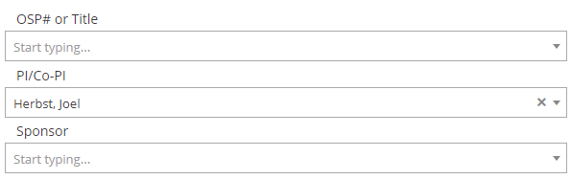
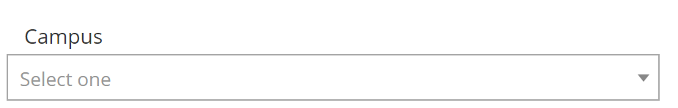
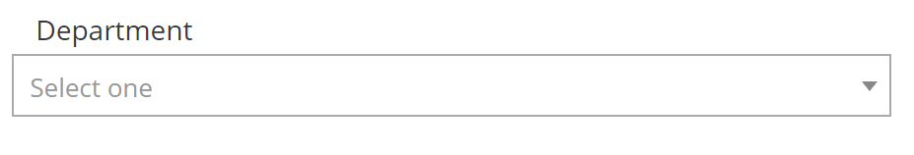
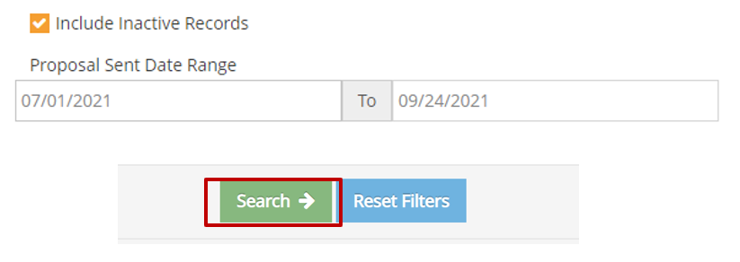
Common Types of Ad hoc Reports
(Examples)
Proposal Submission Report
Commonly used to determine the number of proposals “submitted” during a selected date range
First, select the parameters in which the proposals of interest my include (i.e. within a department, college, etc.)
Once the parameters are selected, enter the “Proposal Sent Date Range”. Please note, this is the parameter the Office of Sponsored Program utilizes to run its quarterly and annual proposal reports
Be sure to “Include Inactive Records” to include proposals already marked as “not funded”

Slide 7
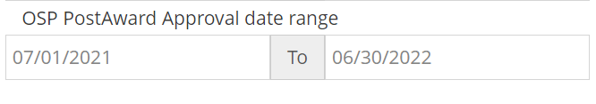

Common Types of Ad hoc Reports
(Examples Continue)
Awards Received Report
Commonly used to determine the number of awards “received” during a selected date range
First, select the parameters in which the proposals of interest my include (i.e. within a department, college, etc.)
Once the parameters are selected, enter the “OSP PostAward Approval date range”. Please note, this is the parameter the Office of Sponsored Program utilizes to run its quarterly and annual award reports

Slide 8
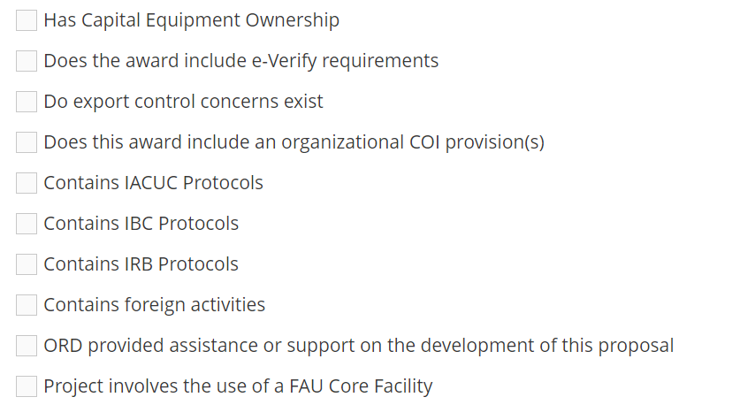
Common Types of Ad hoc Reports
(Examples Continue)
Reports Based on Screening Questions and Compliance Selections
Commonly used to determine which proposals or awards have unique identifiers based on their screening or compliance section(s)
These include but not limited to: Export control, IACUC, IBC, IRB, foreign activities, involves the Office of Research Development and/or FAU Core Facilities
First, select the parameters report and then check the screening or compliance of interest

Slide 9
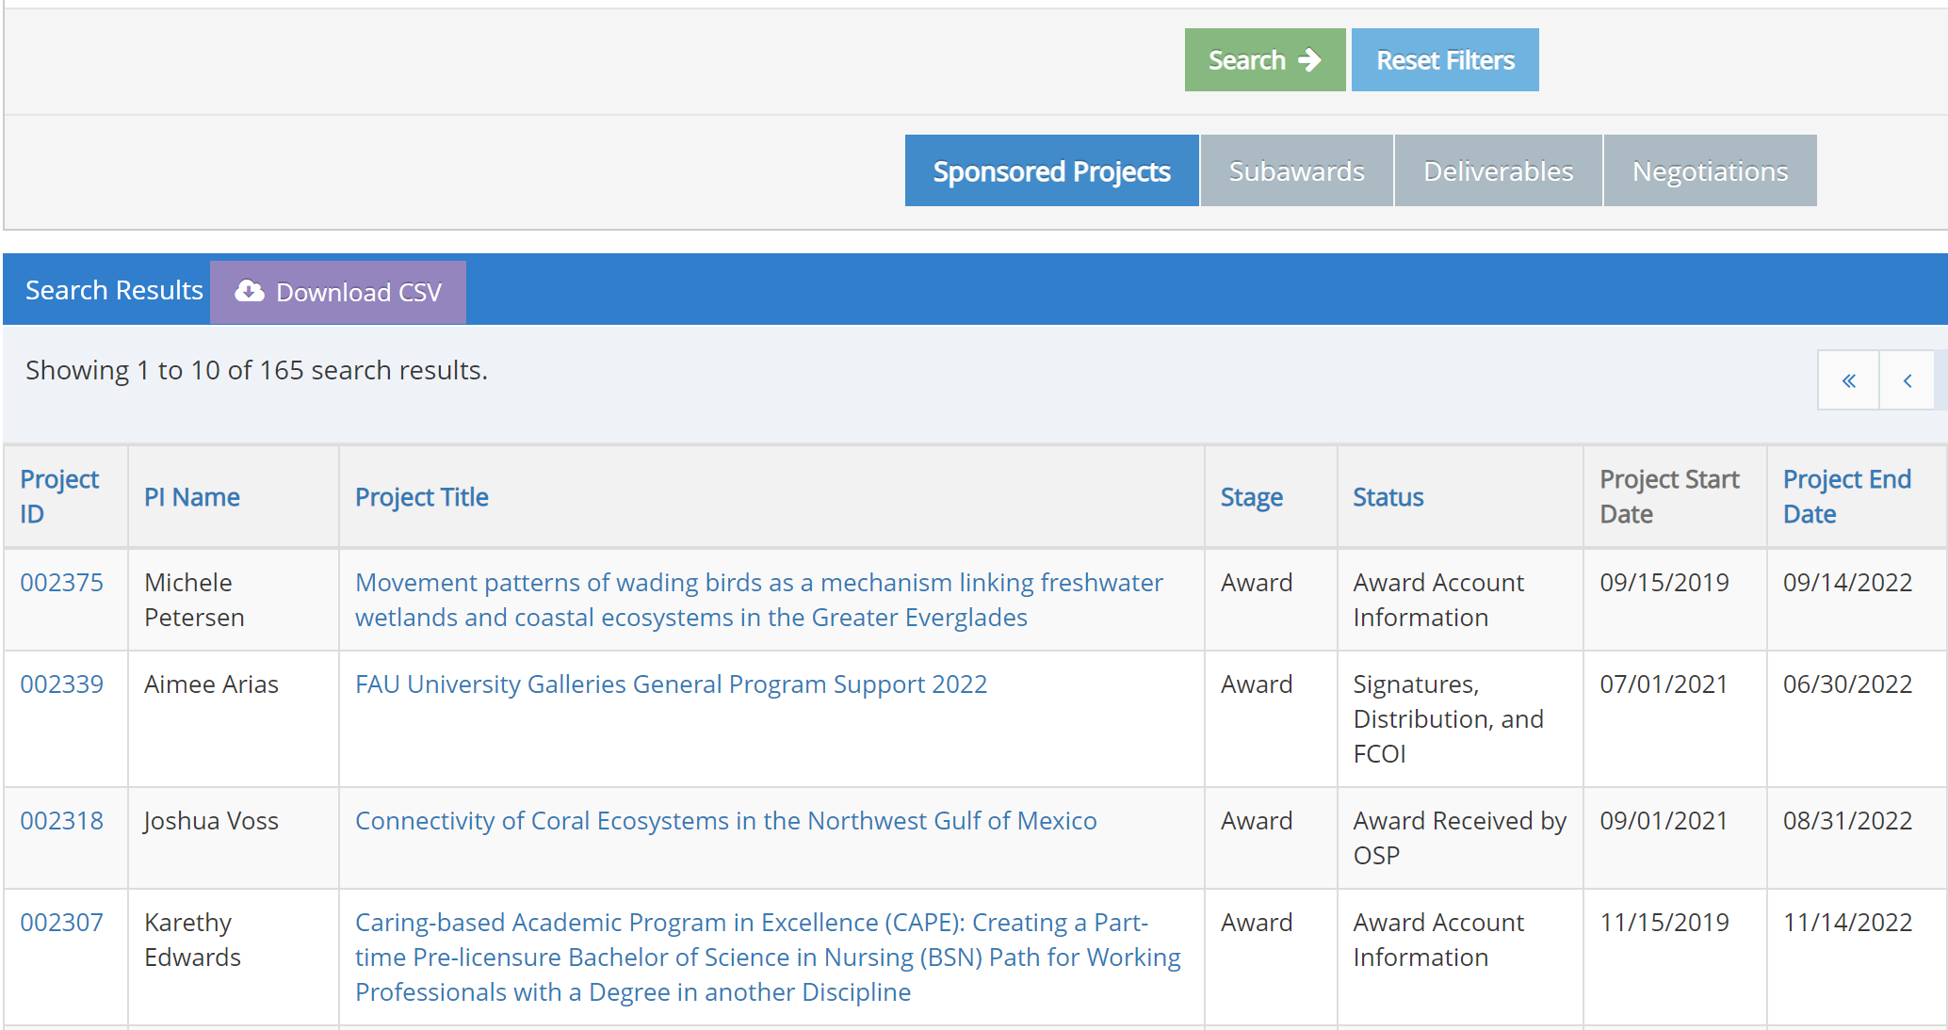
Search Results based on Selected
Filters (parameters)
Search Results and Download as CSV
Once all parameters are determined, click the green “Search” button
The results will then appear below the “Search Results” section. Please note that more than 10 records may exist and the user will need to toggle to the next page to access these results
If the results are satisfactory, the user can download the results as a “CSV” file
A CSV (comma-separated value) file is a delimited text value that uses commas to separate values
CSV files appear very similarly to an Excel File

Slide 10
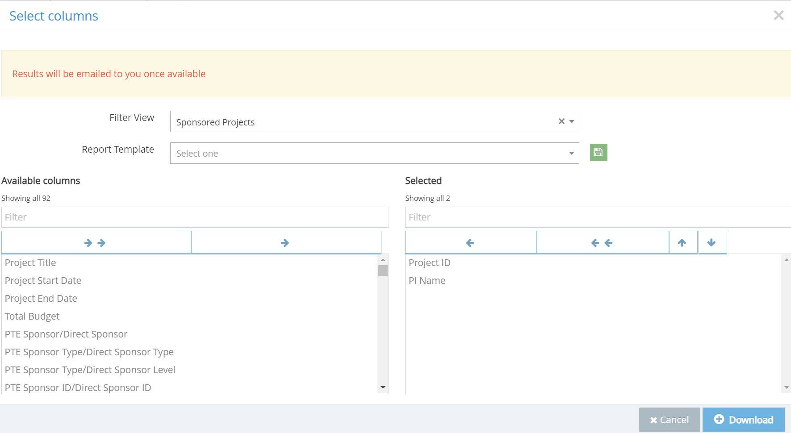
Download CSV and Column
Selections
Sections of Column(s) to Generate the CSV File
Once the “Download” CSV button is selected, the user must select the “column(s)” to be generated on the CSV file
Columns are specific data values entered in the proposal/award file
Highlight the column(s) of interest and in the left-hand box and click on the “single” arrow pointing to the right to move that column over

Slide 11
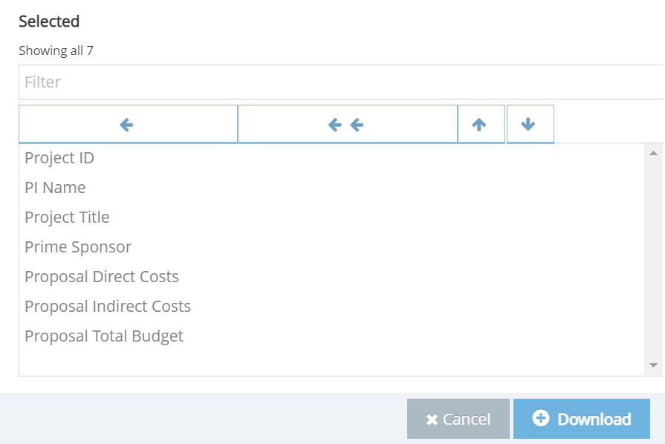
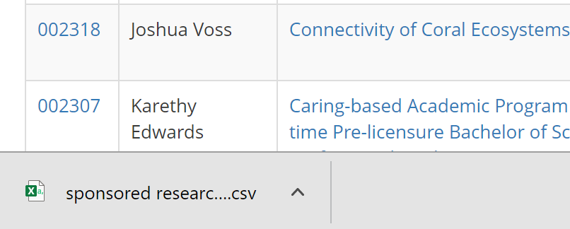
Column Selections (Cont.)
Sections of Column(s) (Cont.)
Once all columns of interests are selected, the user can order the columns by highlighting the column and using the up and down arrows
Once all columns are selected, click the blue “Download” button
A CSV file will be generated at bottom left of the screen as an Excel file
If the CSV is too large, the report will appear in your “Notification” inbox when it is available (<30 seconds)

Slide 12

Final Thoughts and Questions
Final Thoughts
The Novelution ad hoc report functionality is a powerful tool for researchers and research administrators to manage their proposal & award portfolio
The Ad hoc report search parameters enables users to report on specific data fields
Depending on the user’s role or access, the user-friendly ad hoc reporting function can provide critical real time data quickly
For questions or assistance utilizing the ad hoc report functions in Novelution, please email the help desk at novelution@fau.edu

